Slide 1
Lecture 4
Advanced Algorithm Analysis

Slide 2
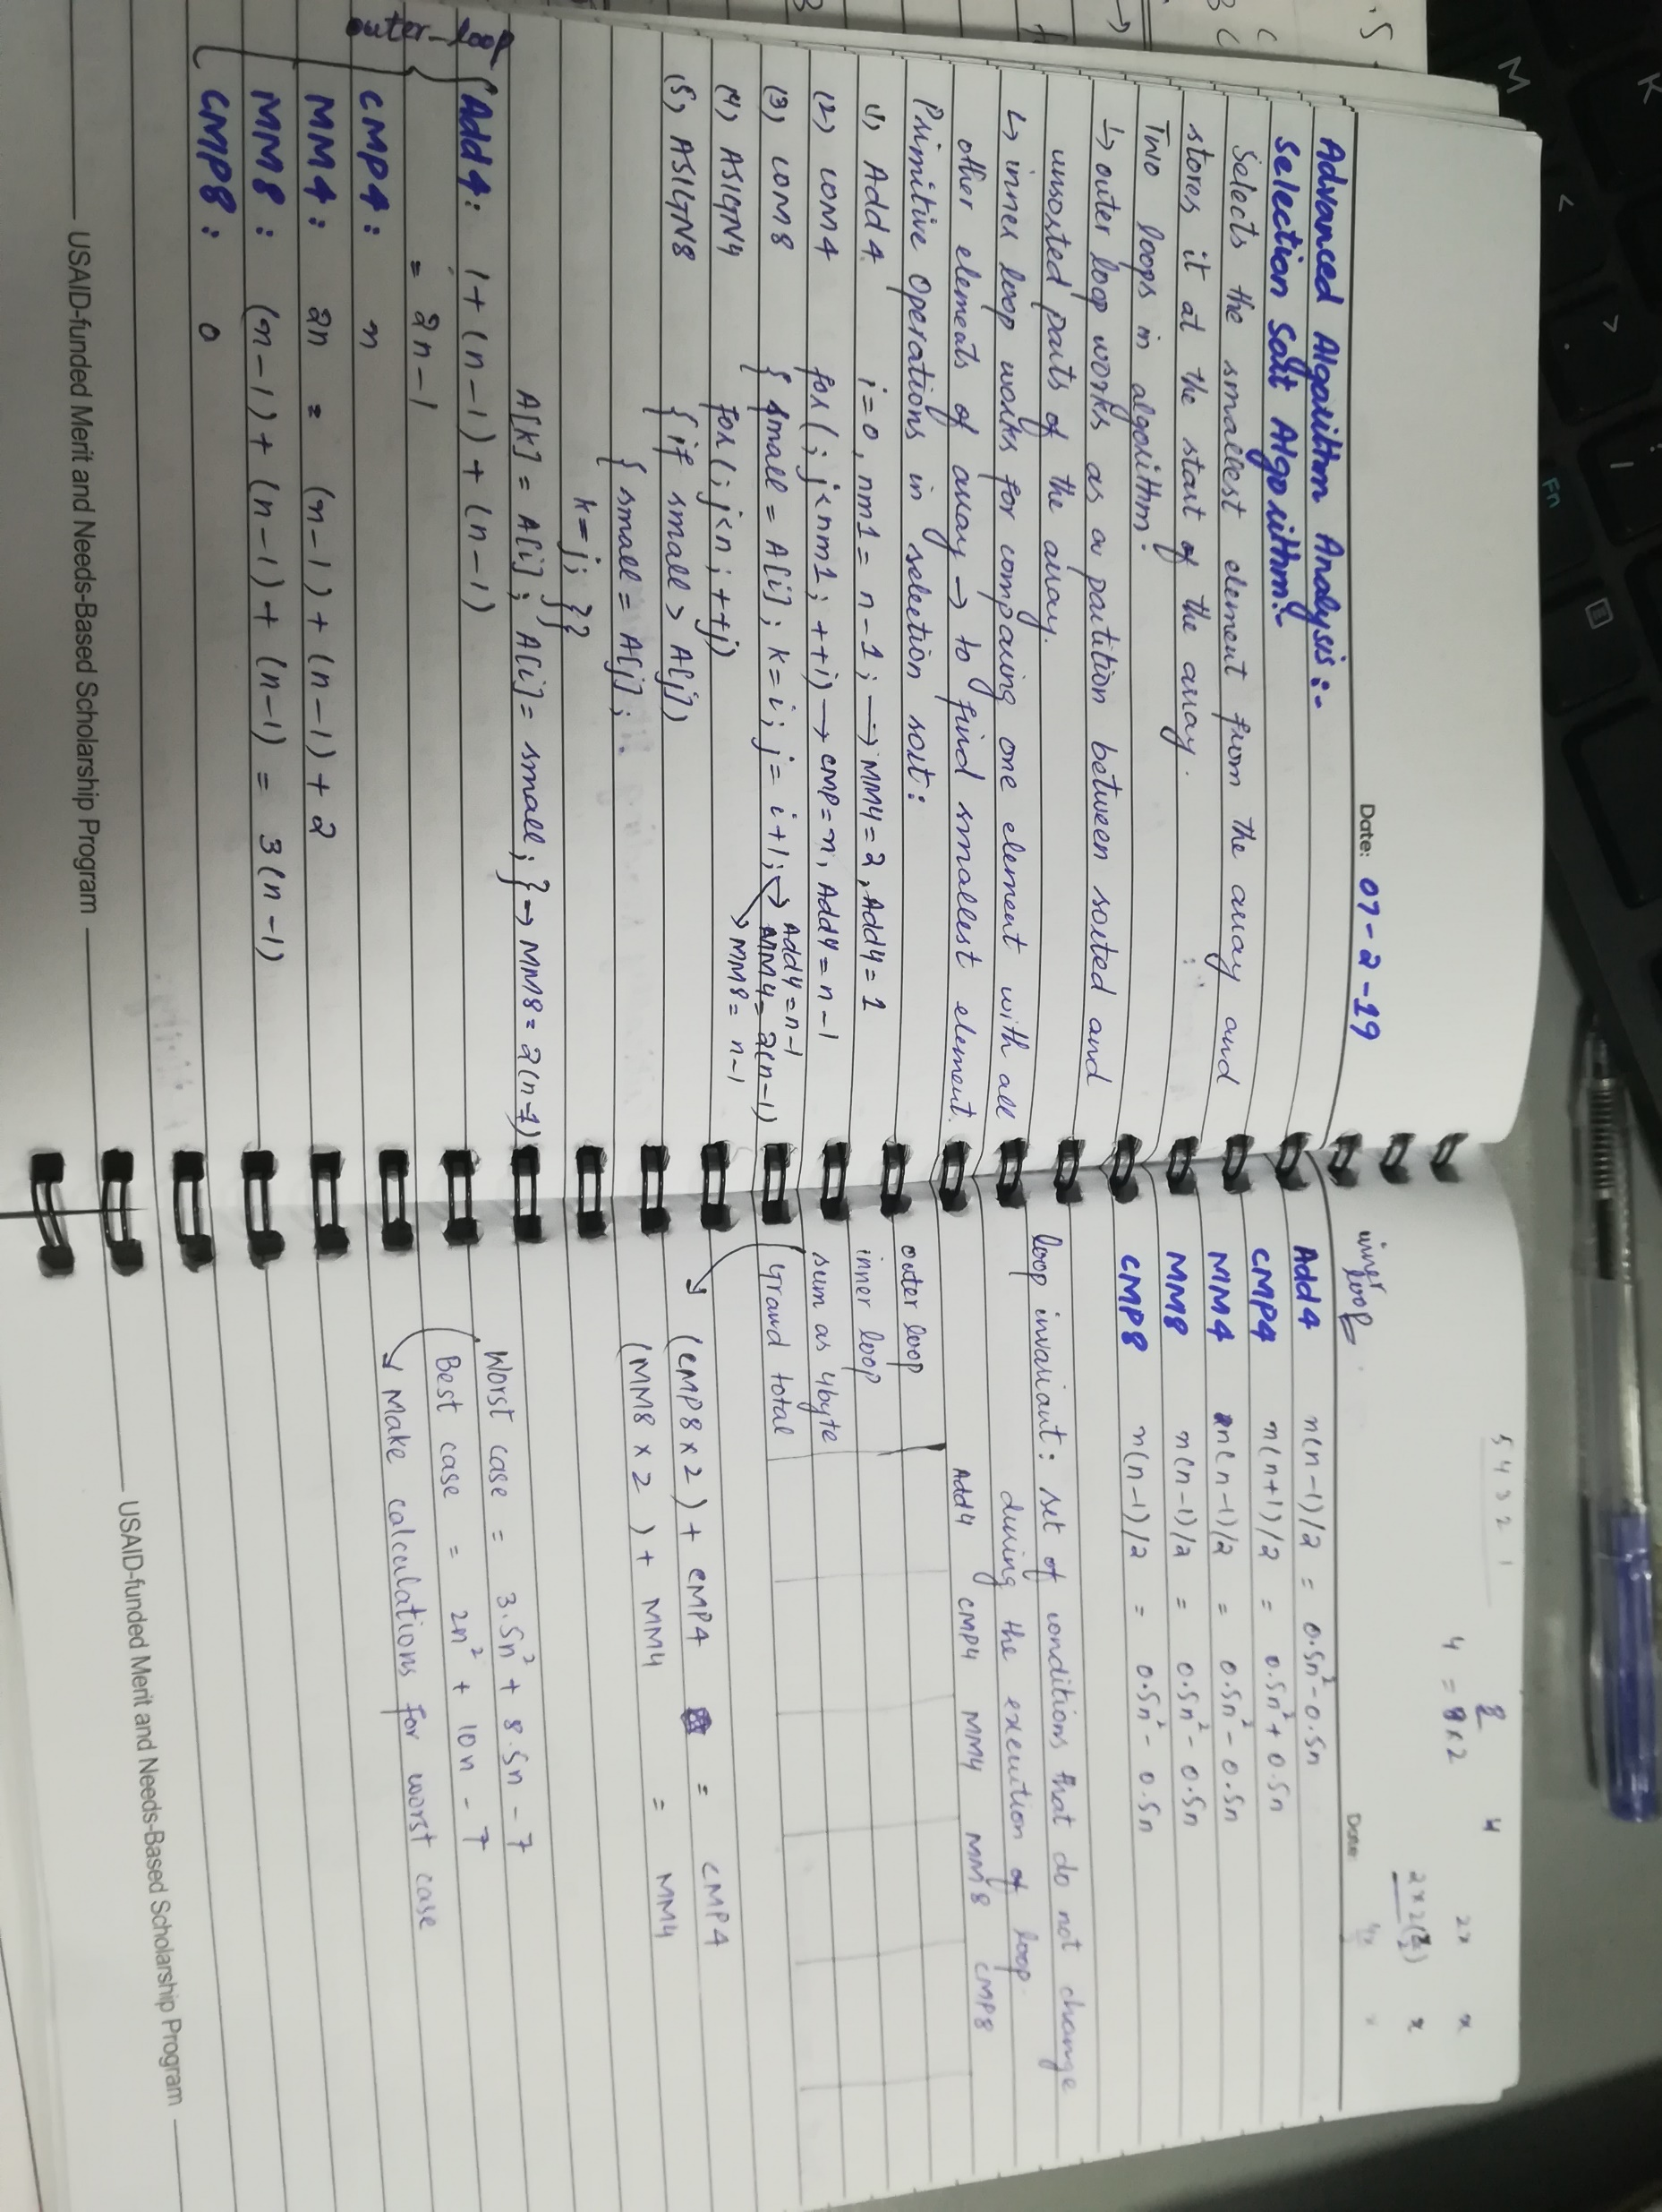

Slide 3
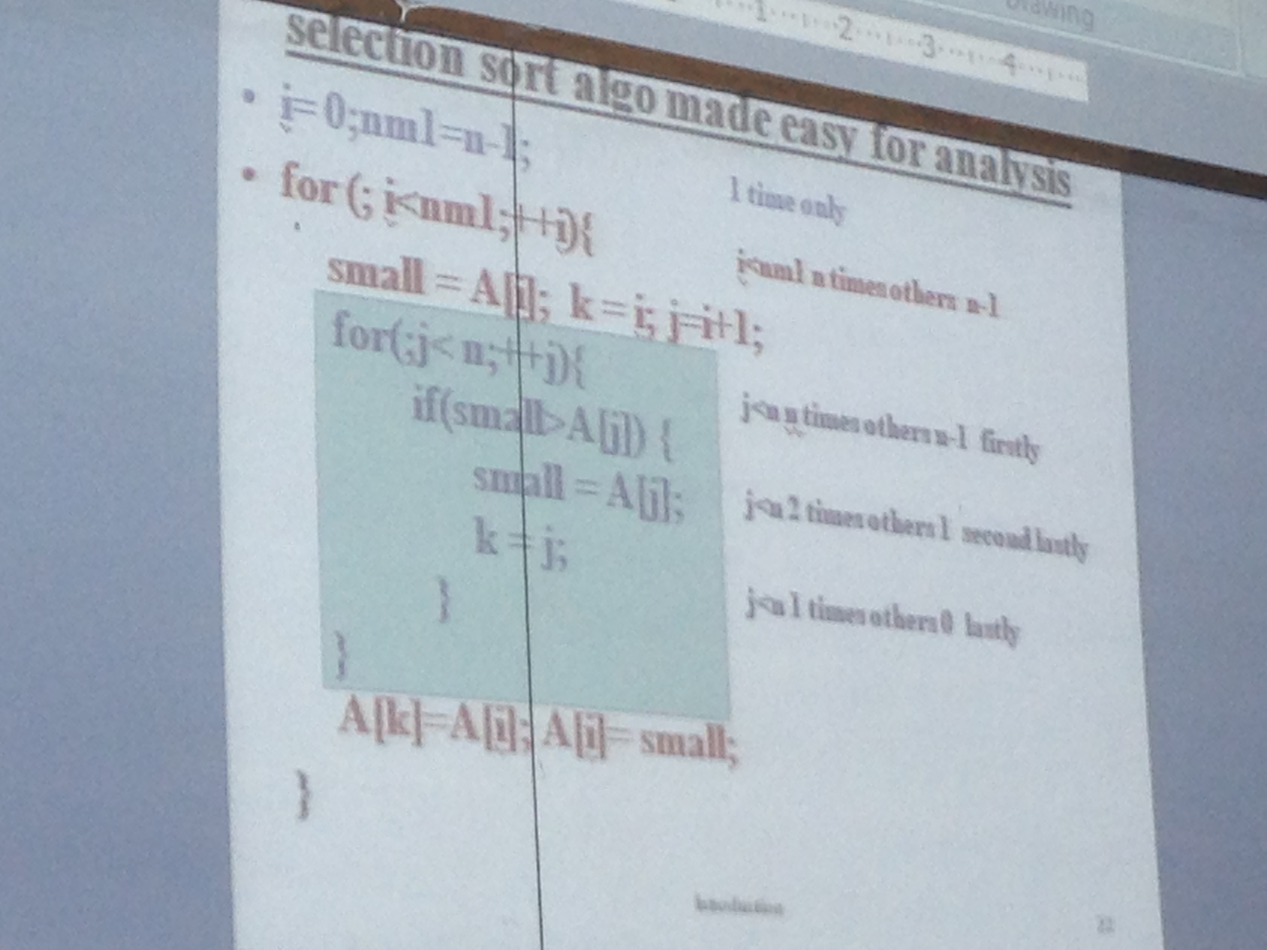
Selection Sort Algorithm

Slide 4
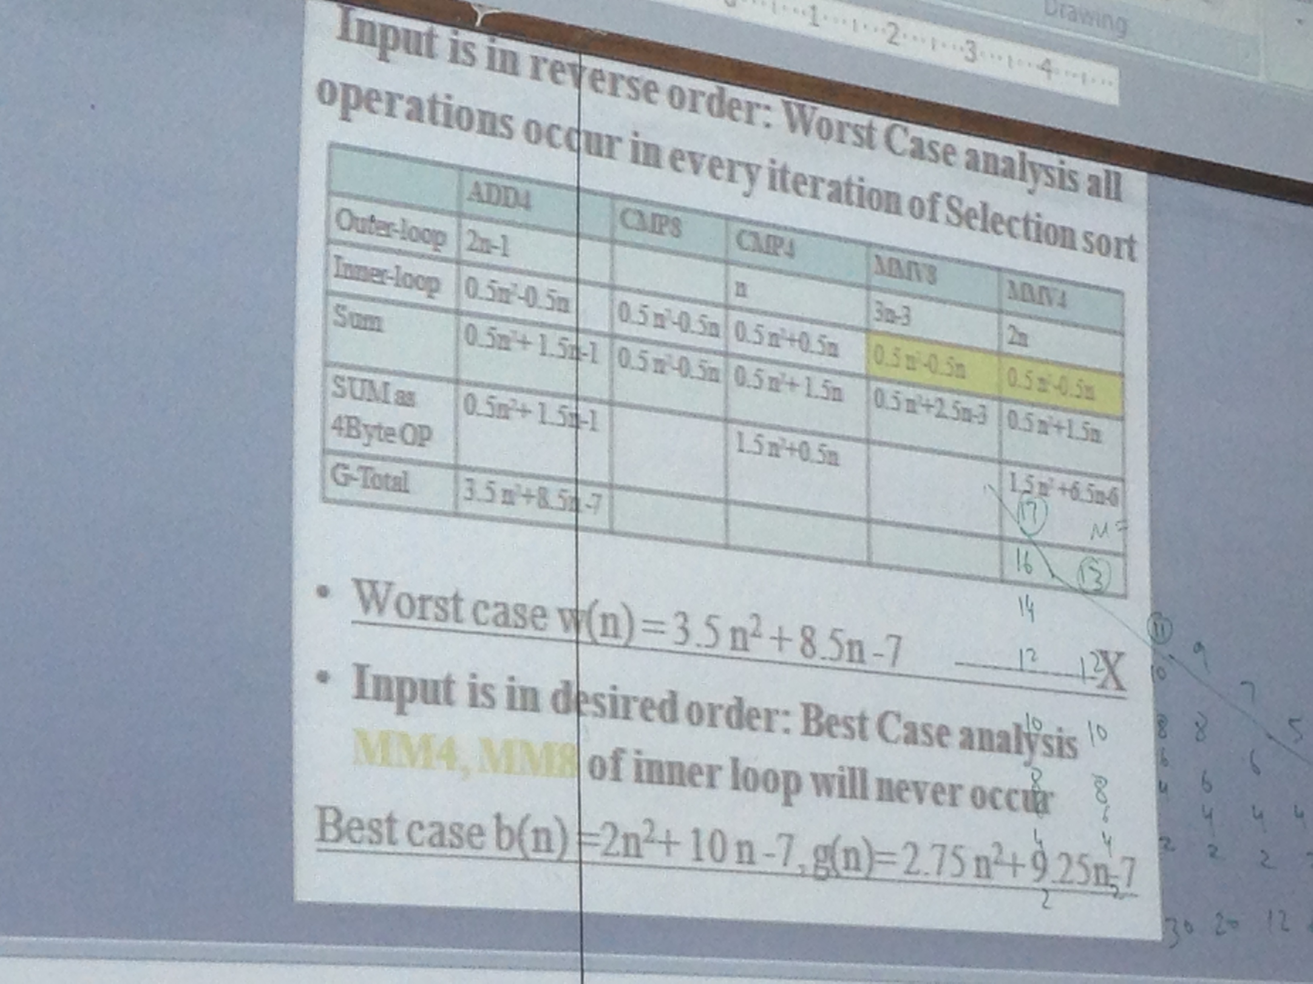
Selection Sort Algorithm (contd…)

Slide 5
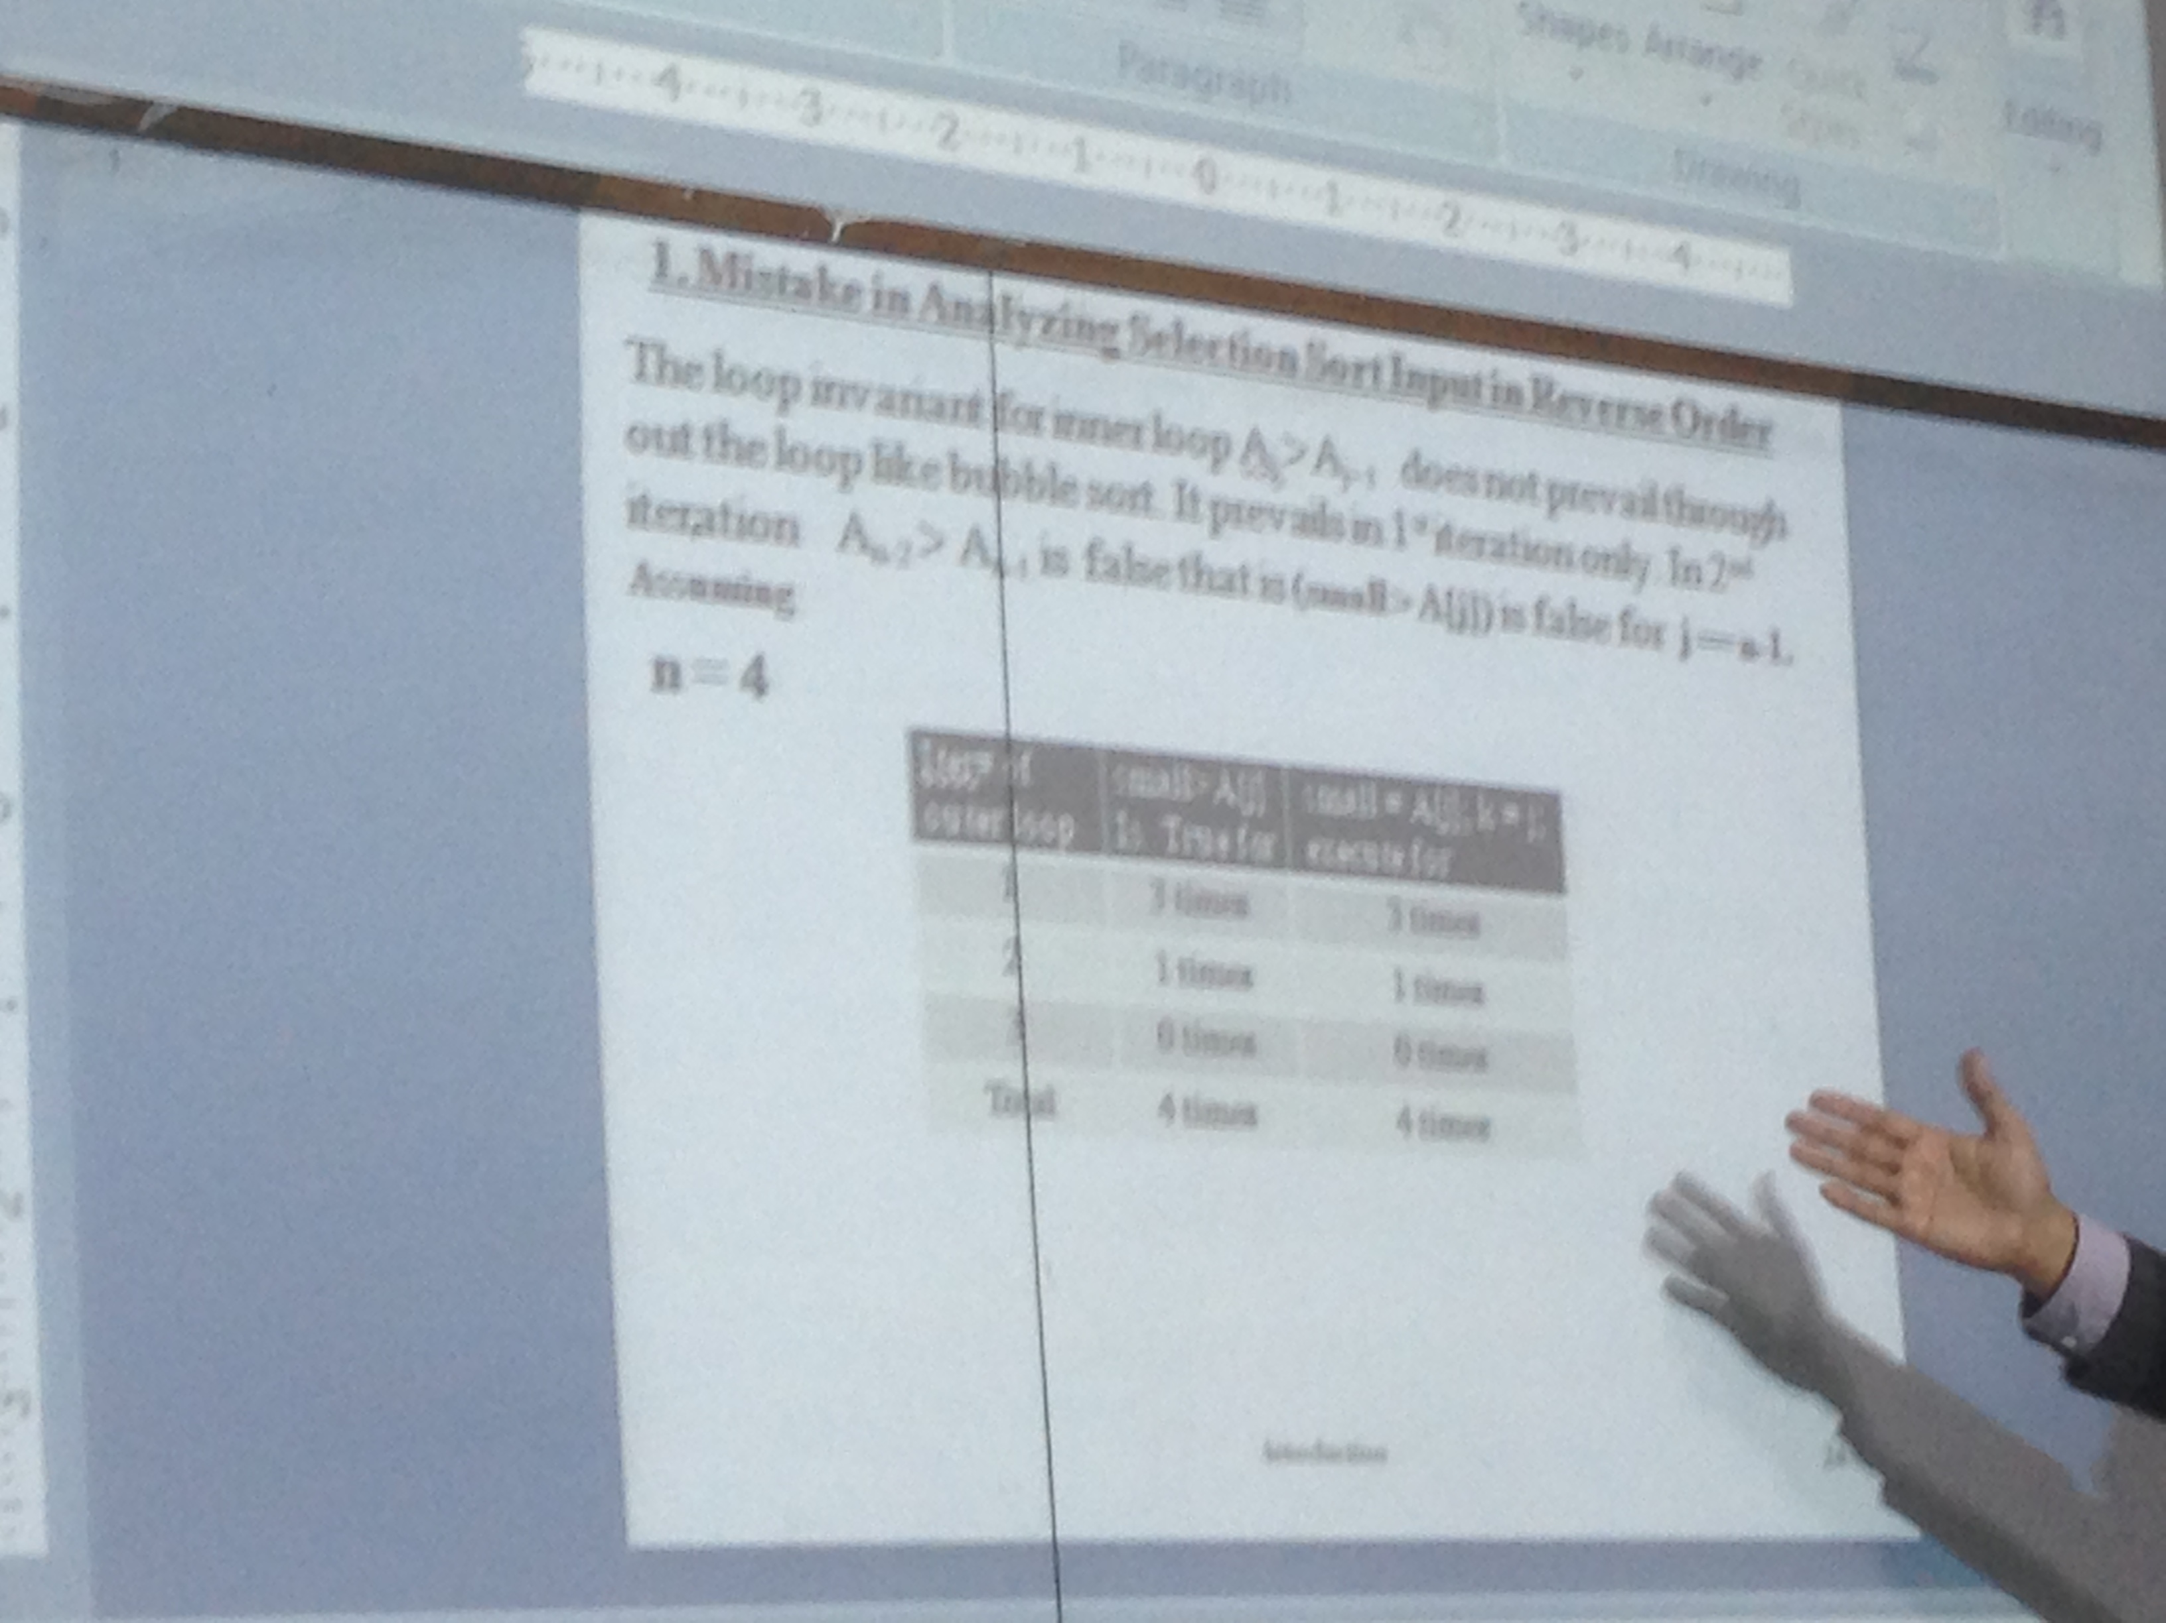
Analysis of “if condition” in the inner loop of selection sort algorithm

Slide 6
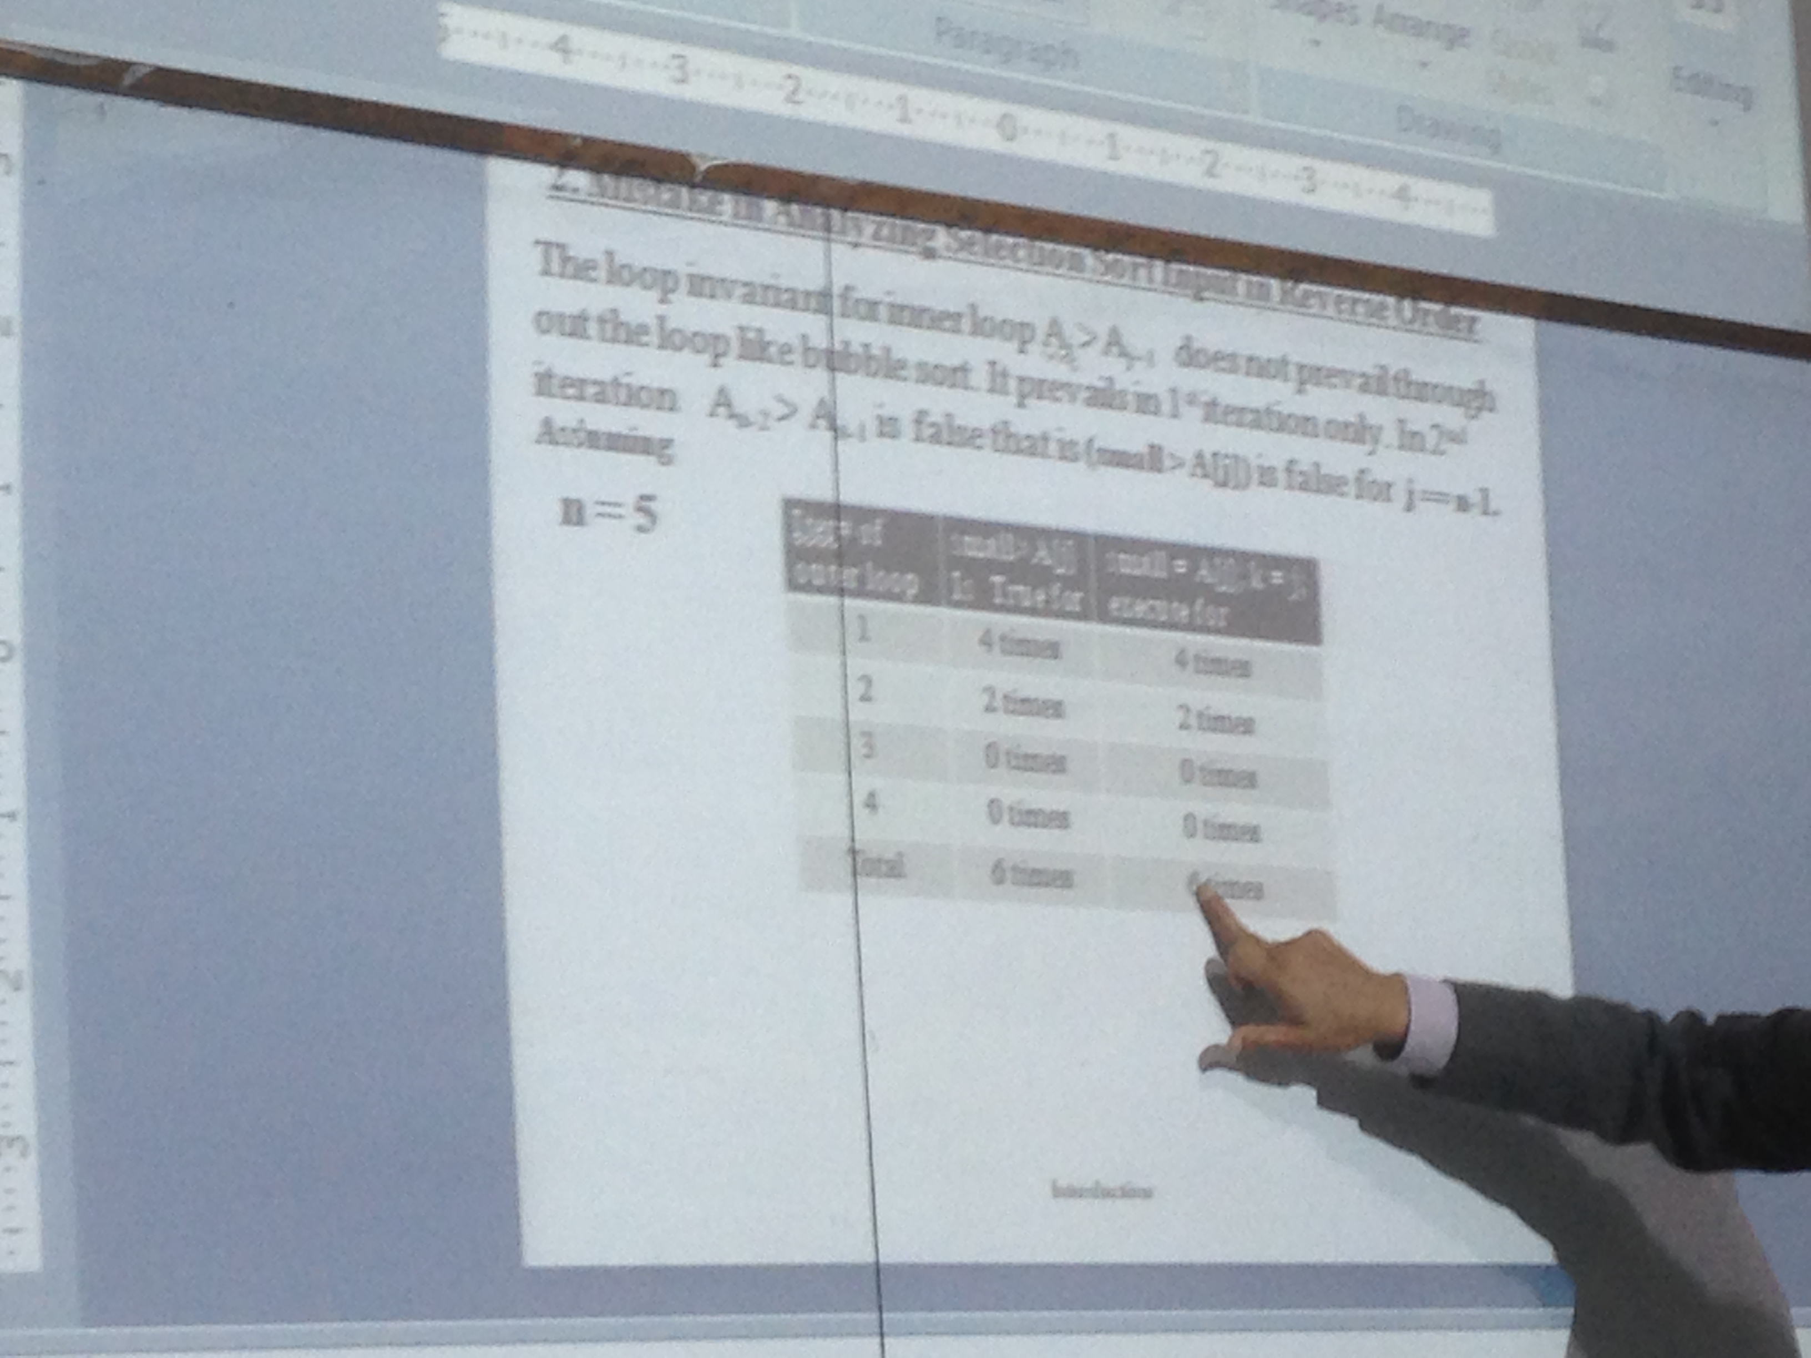
Analysis of “if condition” (contd…)

Slide 7
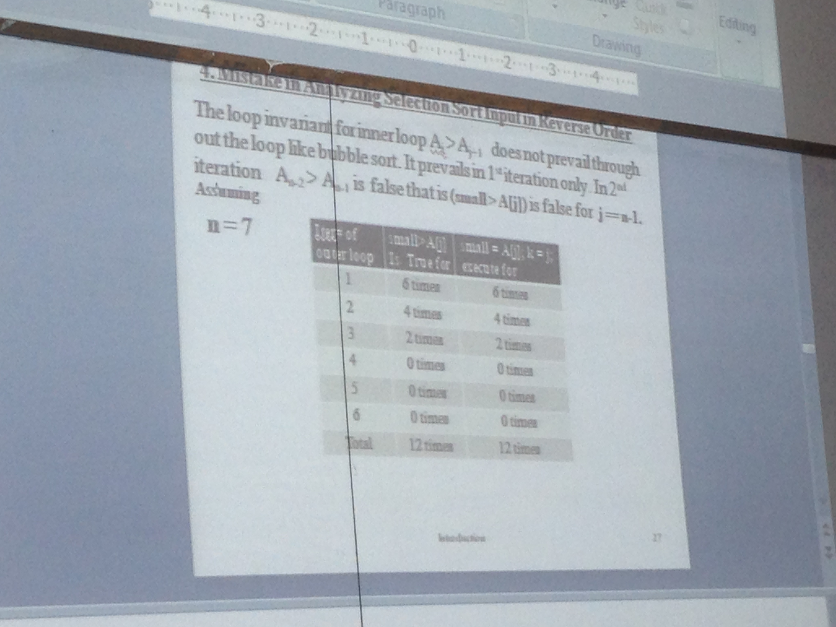
Analysis of “if condition” (contd…)

Slide 8
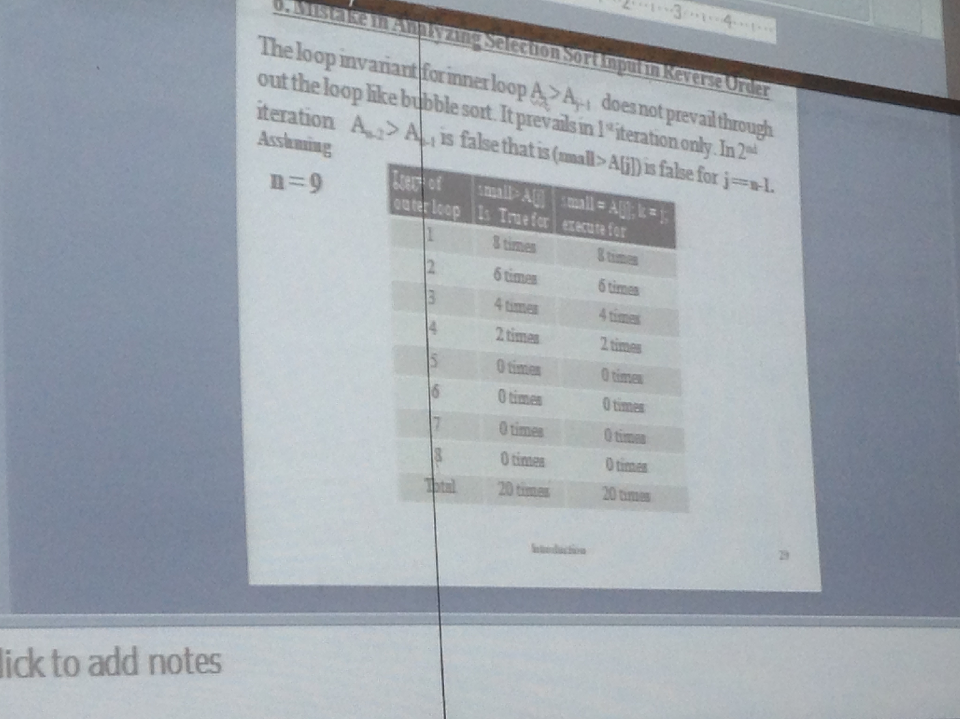
Analysis of “if condition” (contd…)

Slide 9
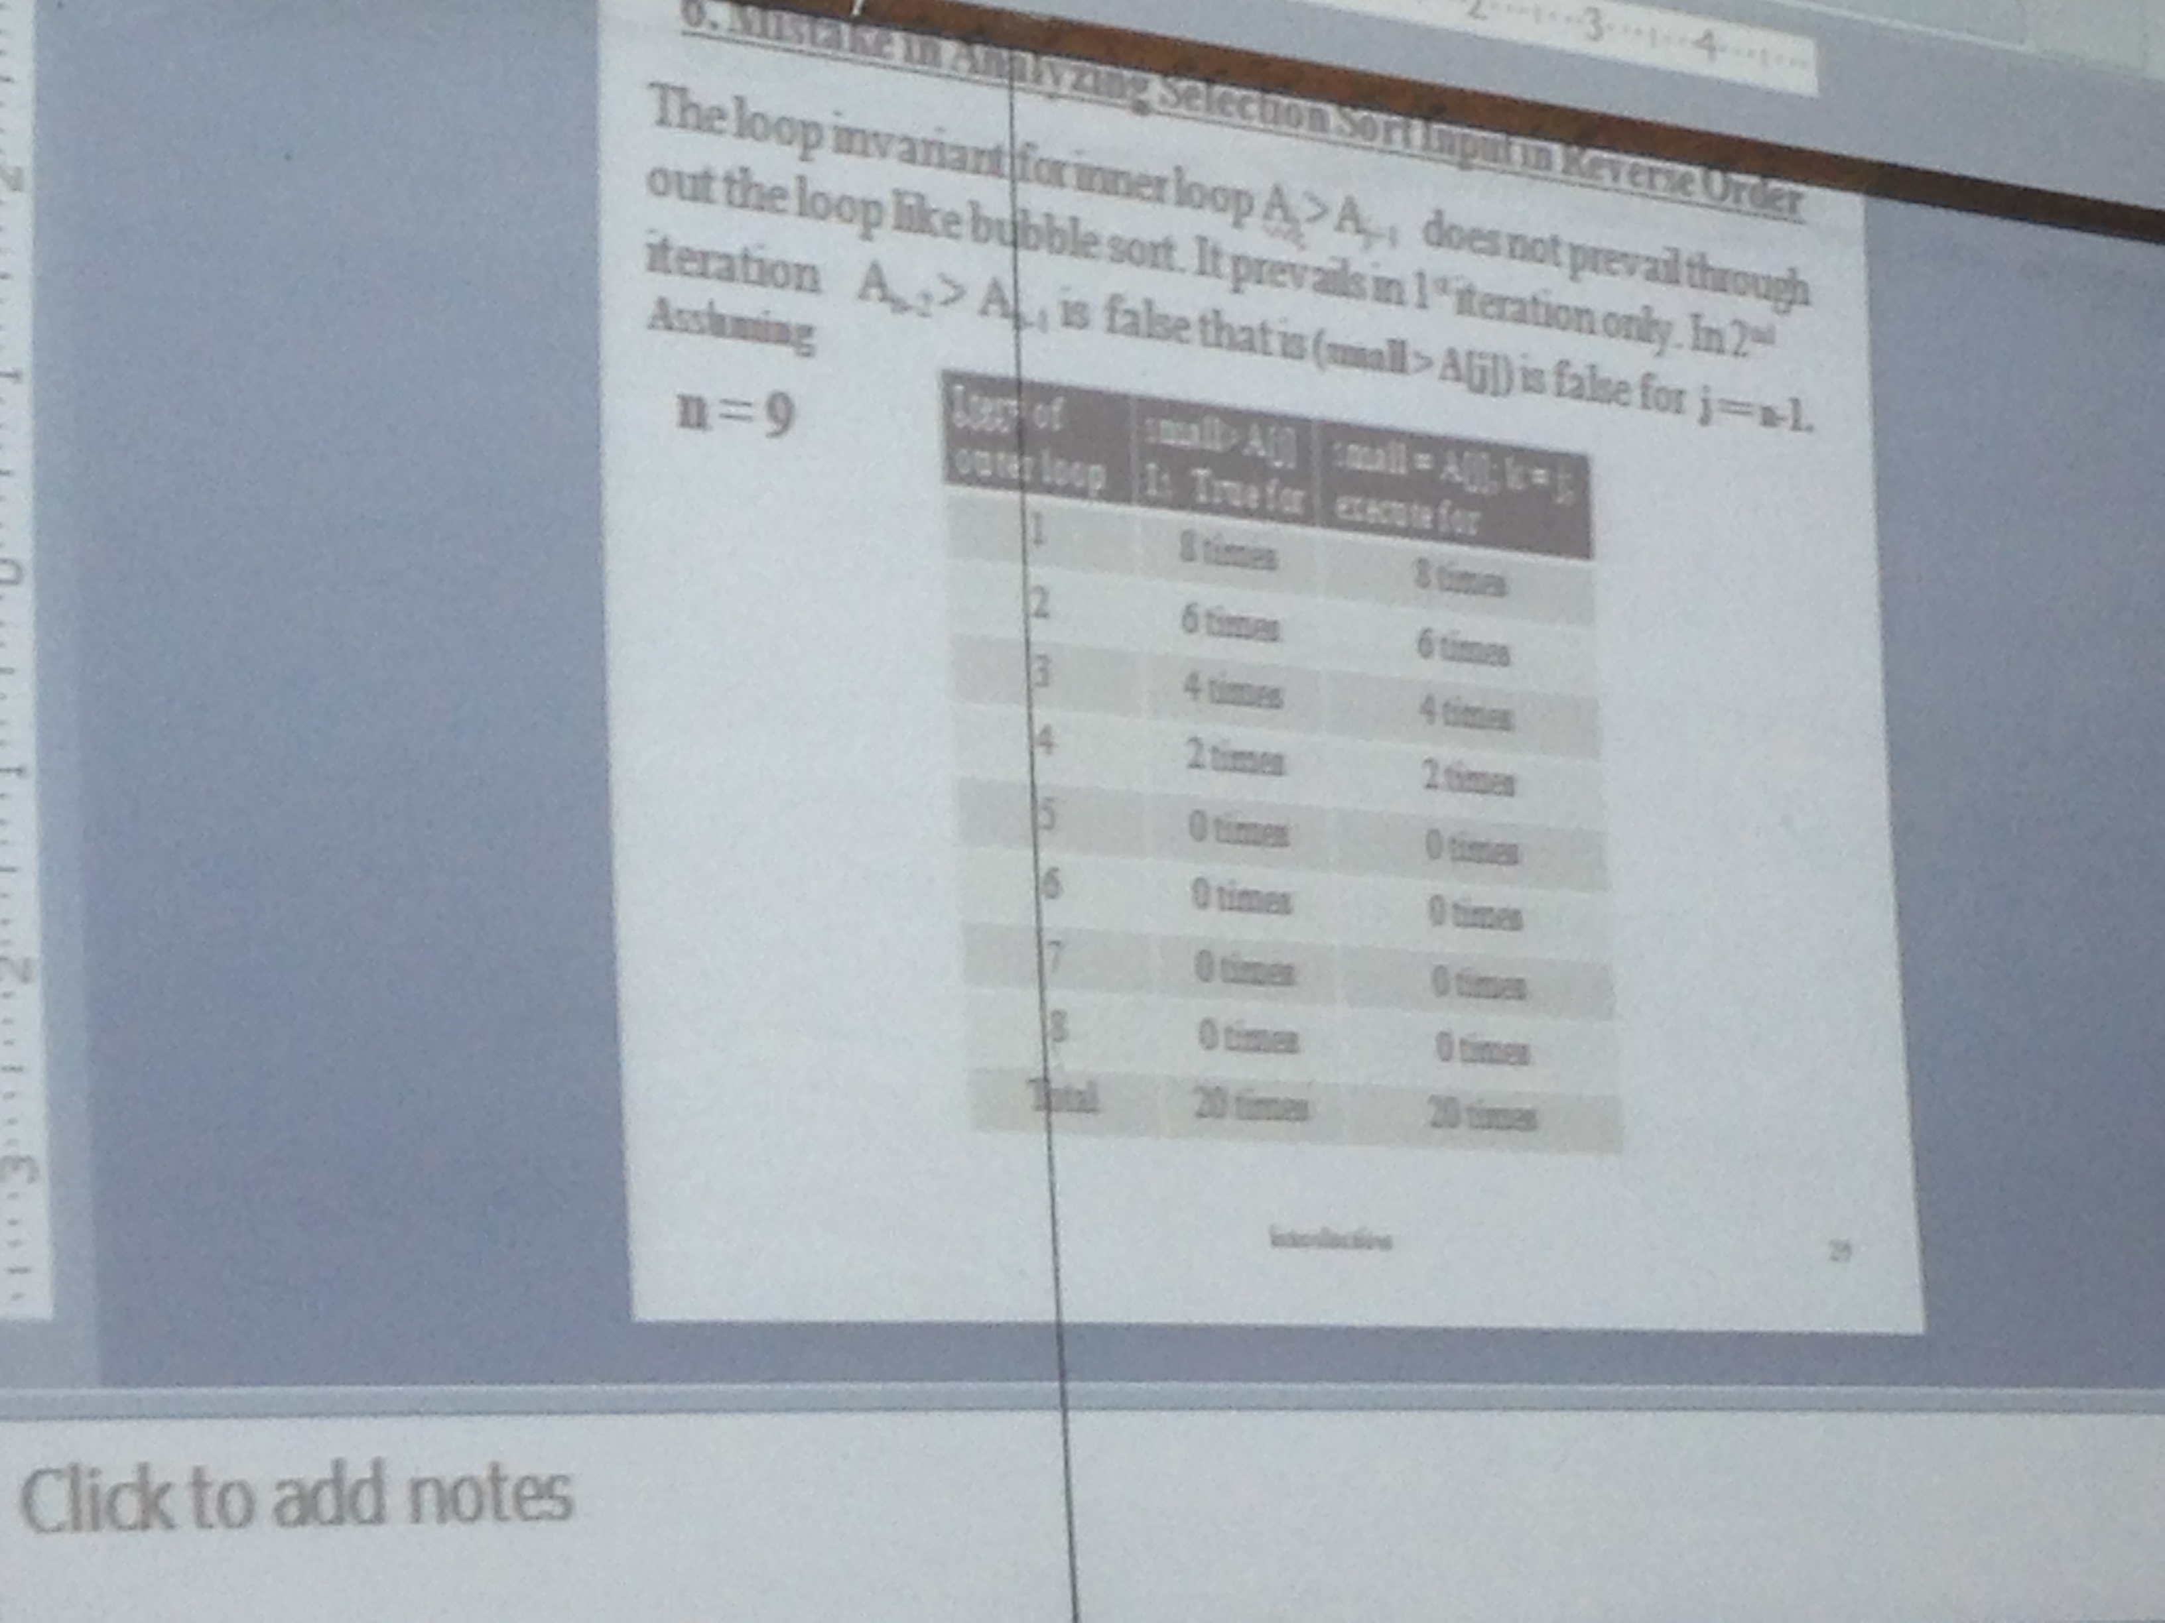
Analysis of “if condition” (contd…)

Slide 10
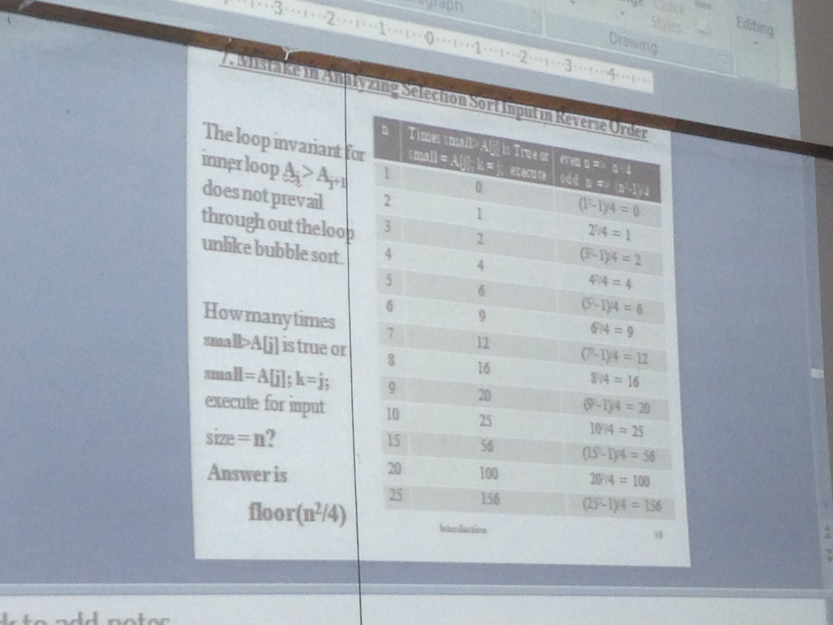
Analysis of “if condition” (contd…)

Slide 11
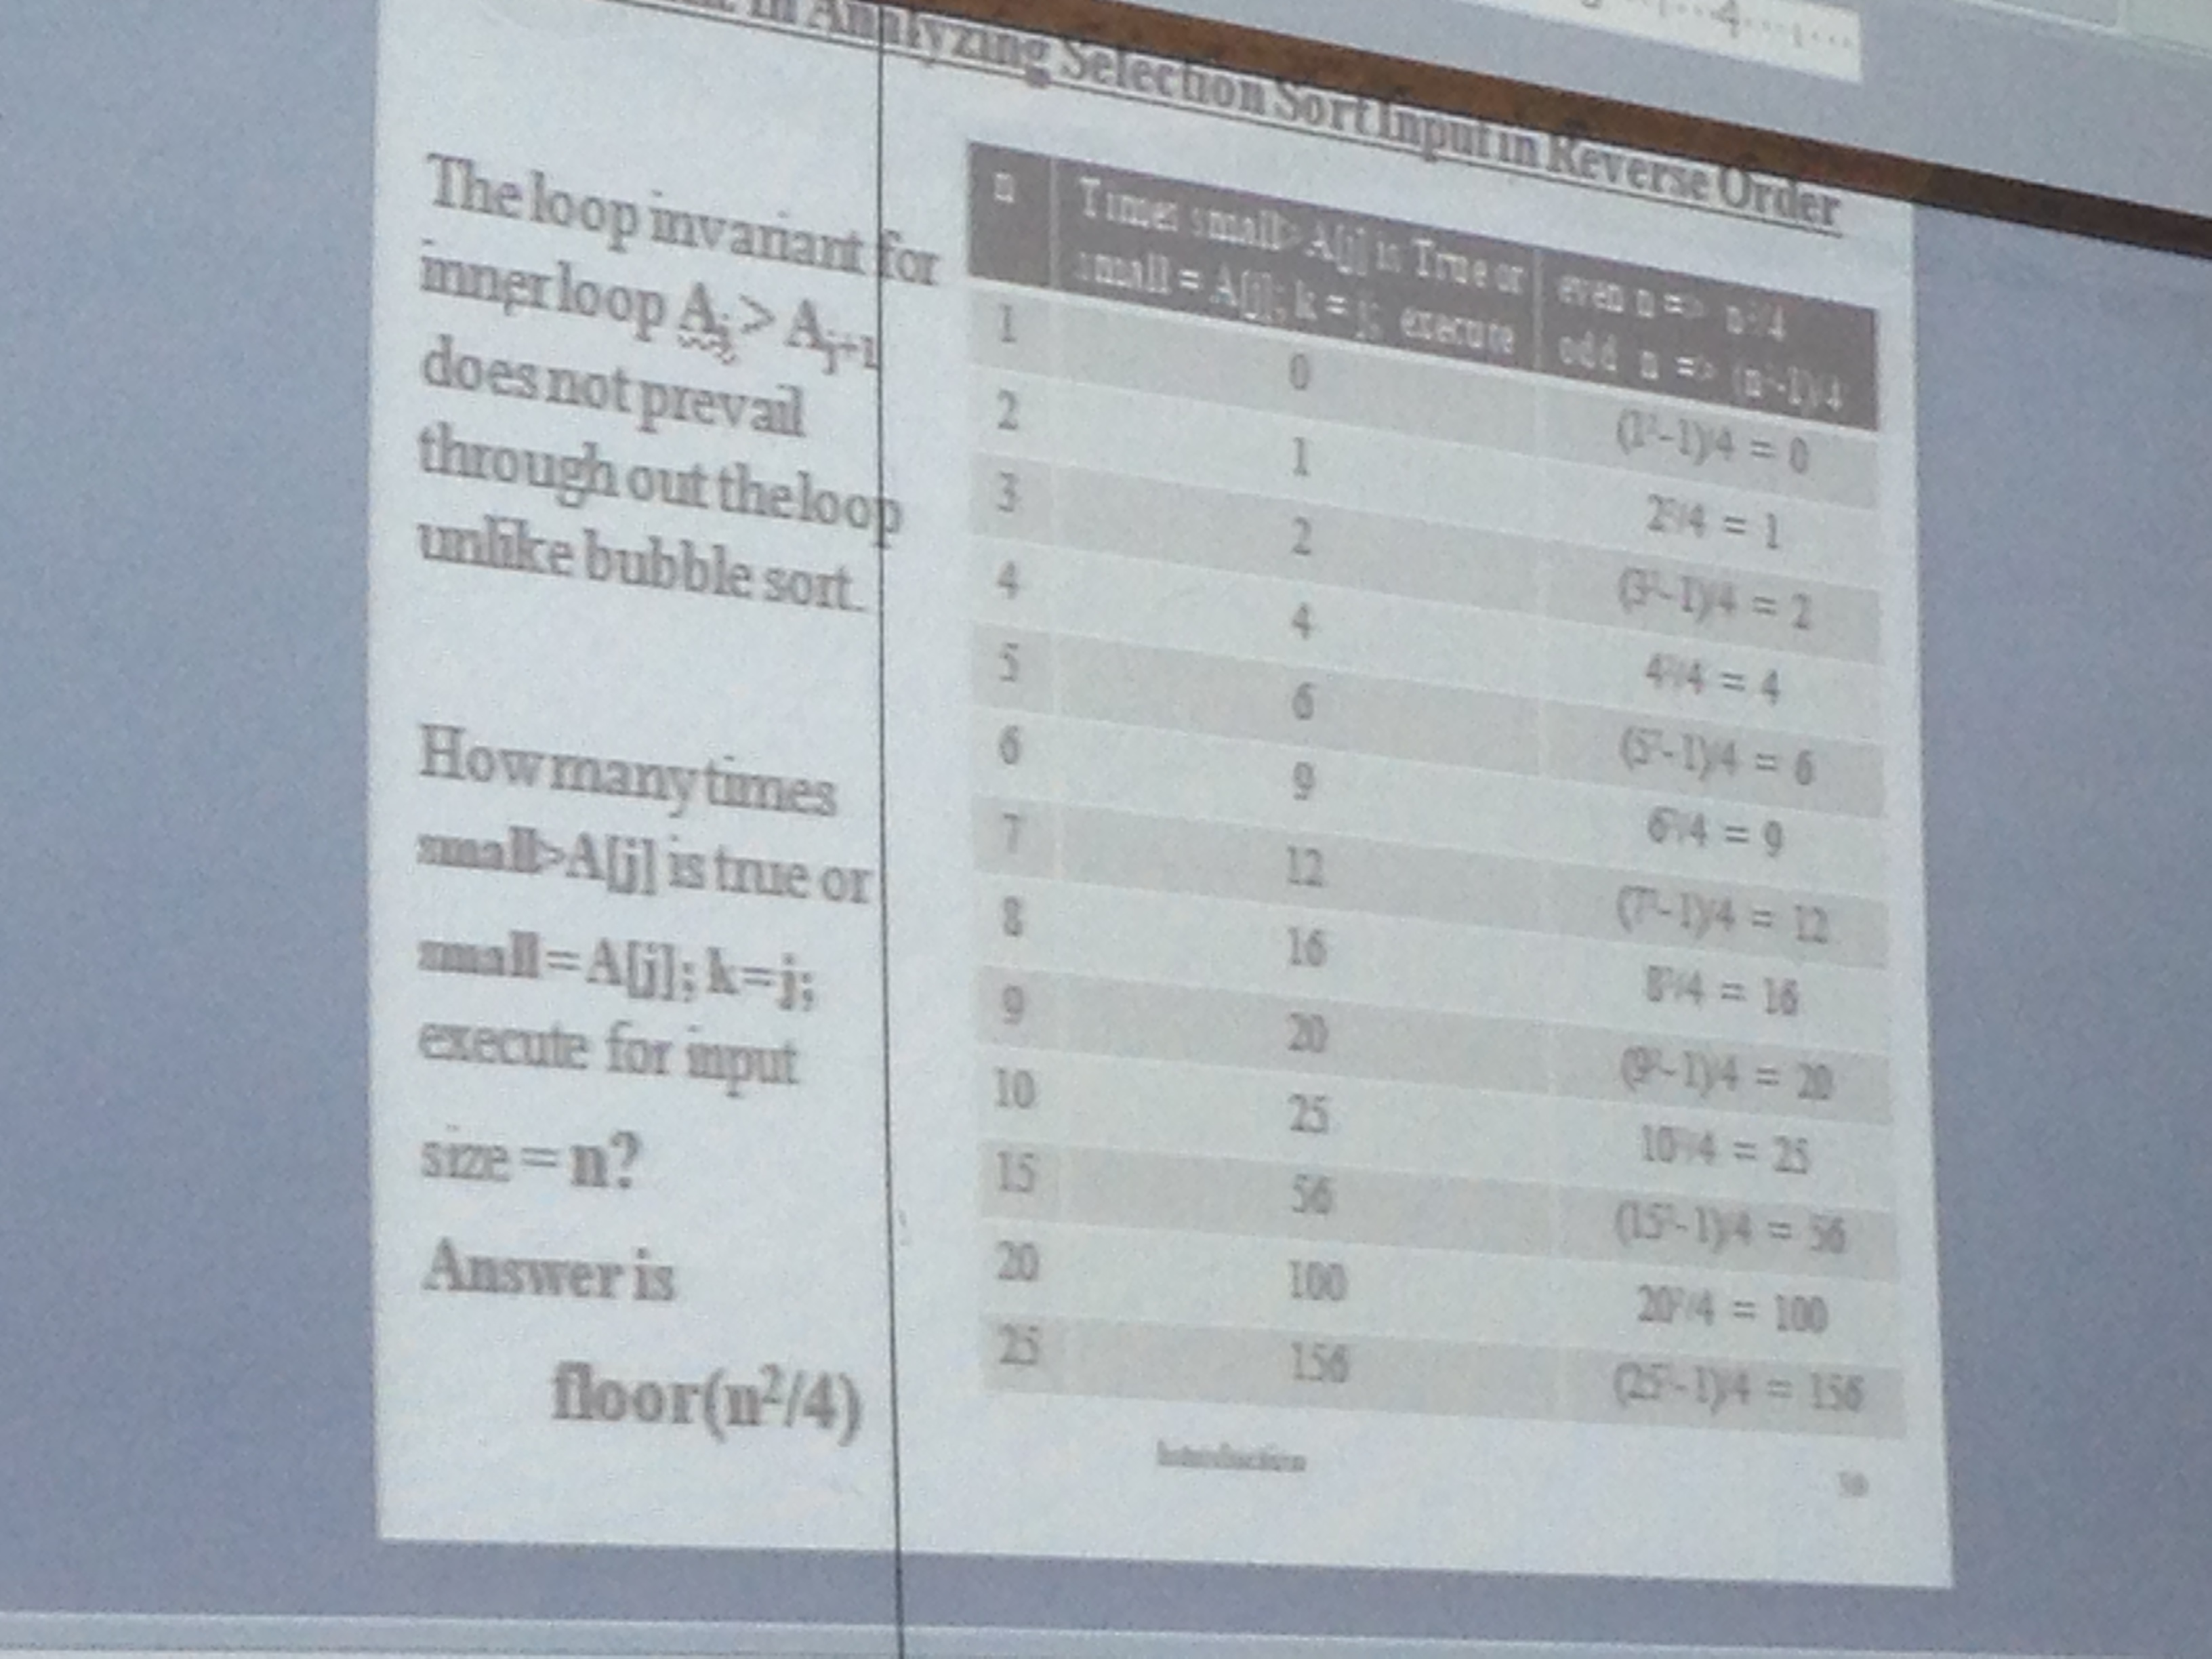
Analysis of “if condition” (contd…)

Slide 12
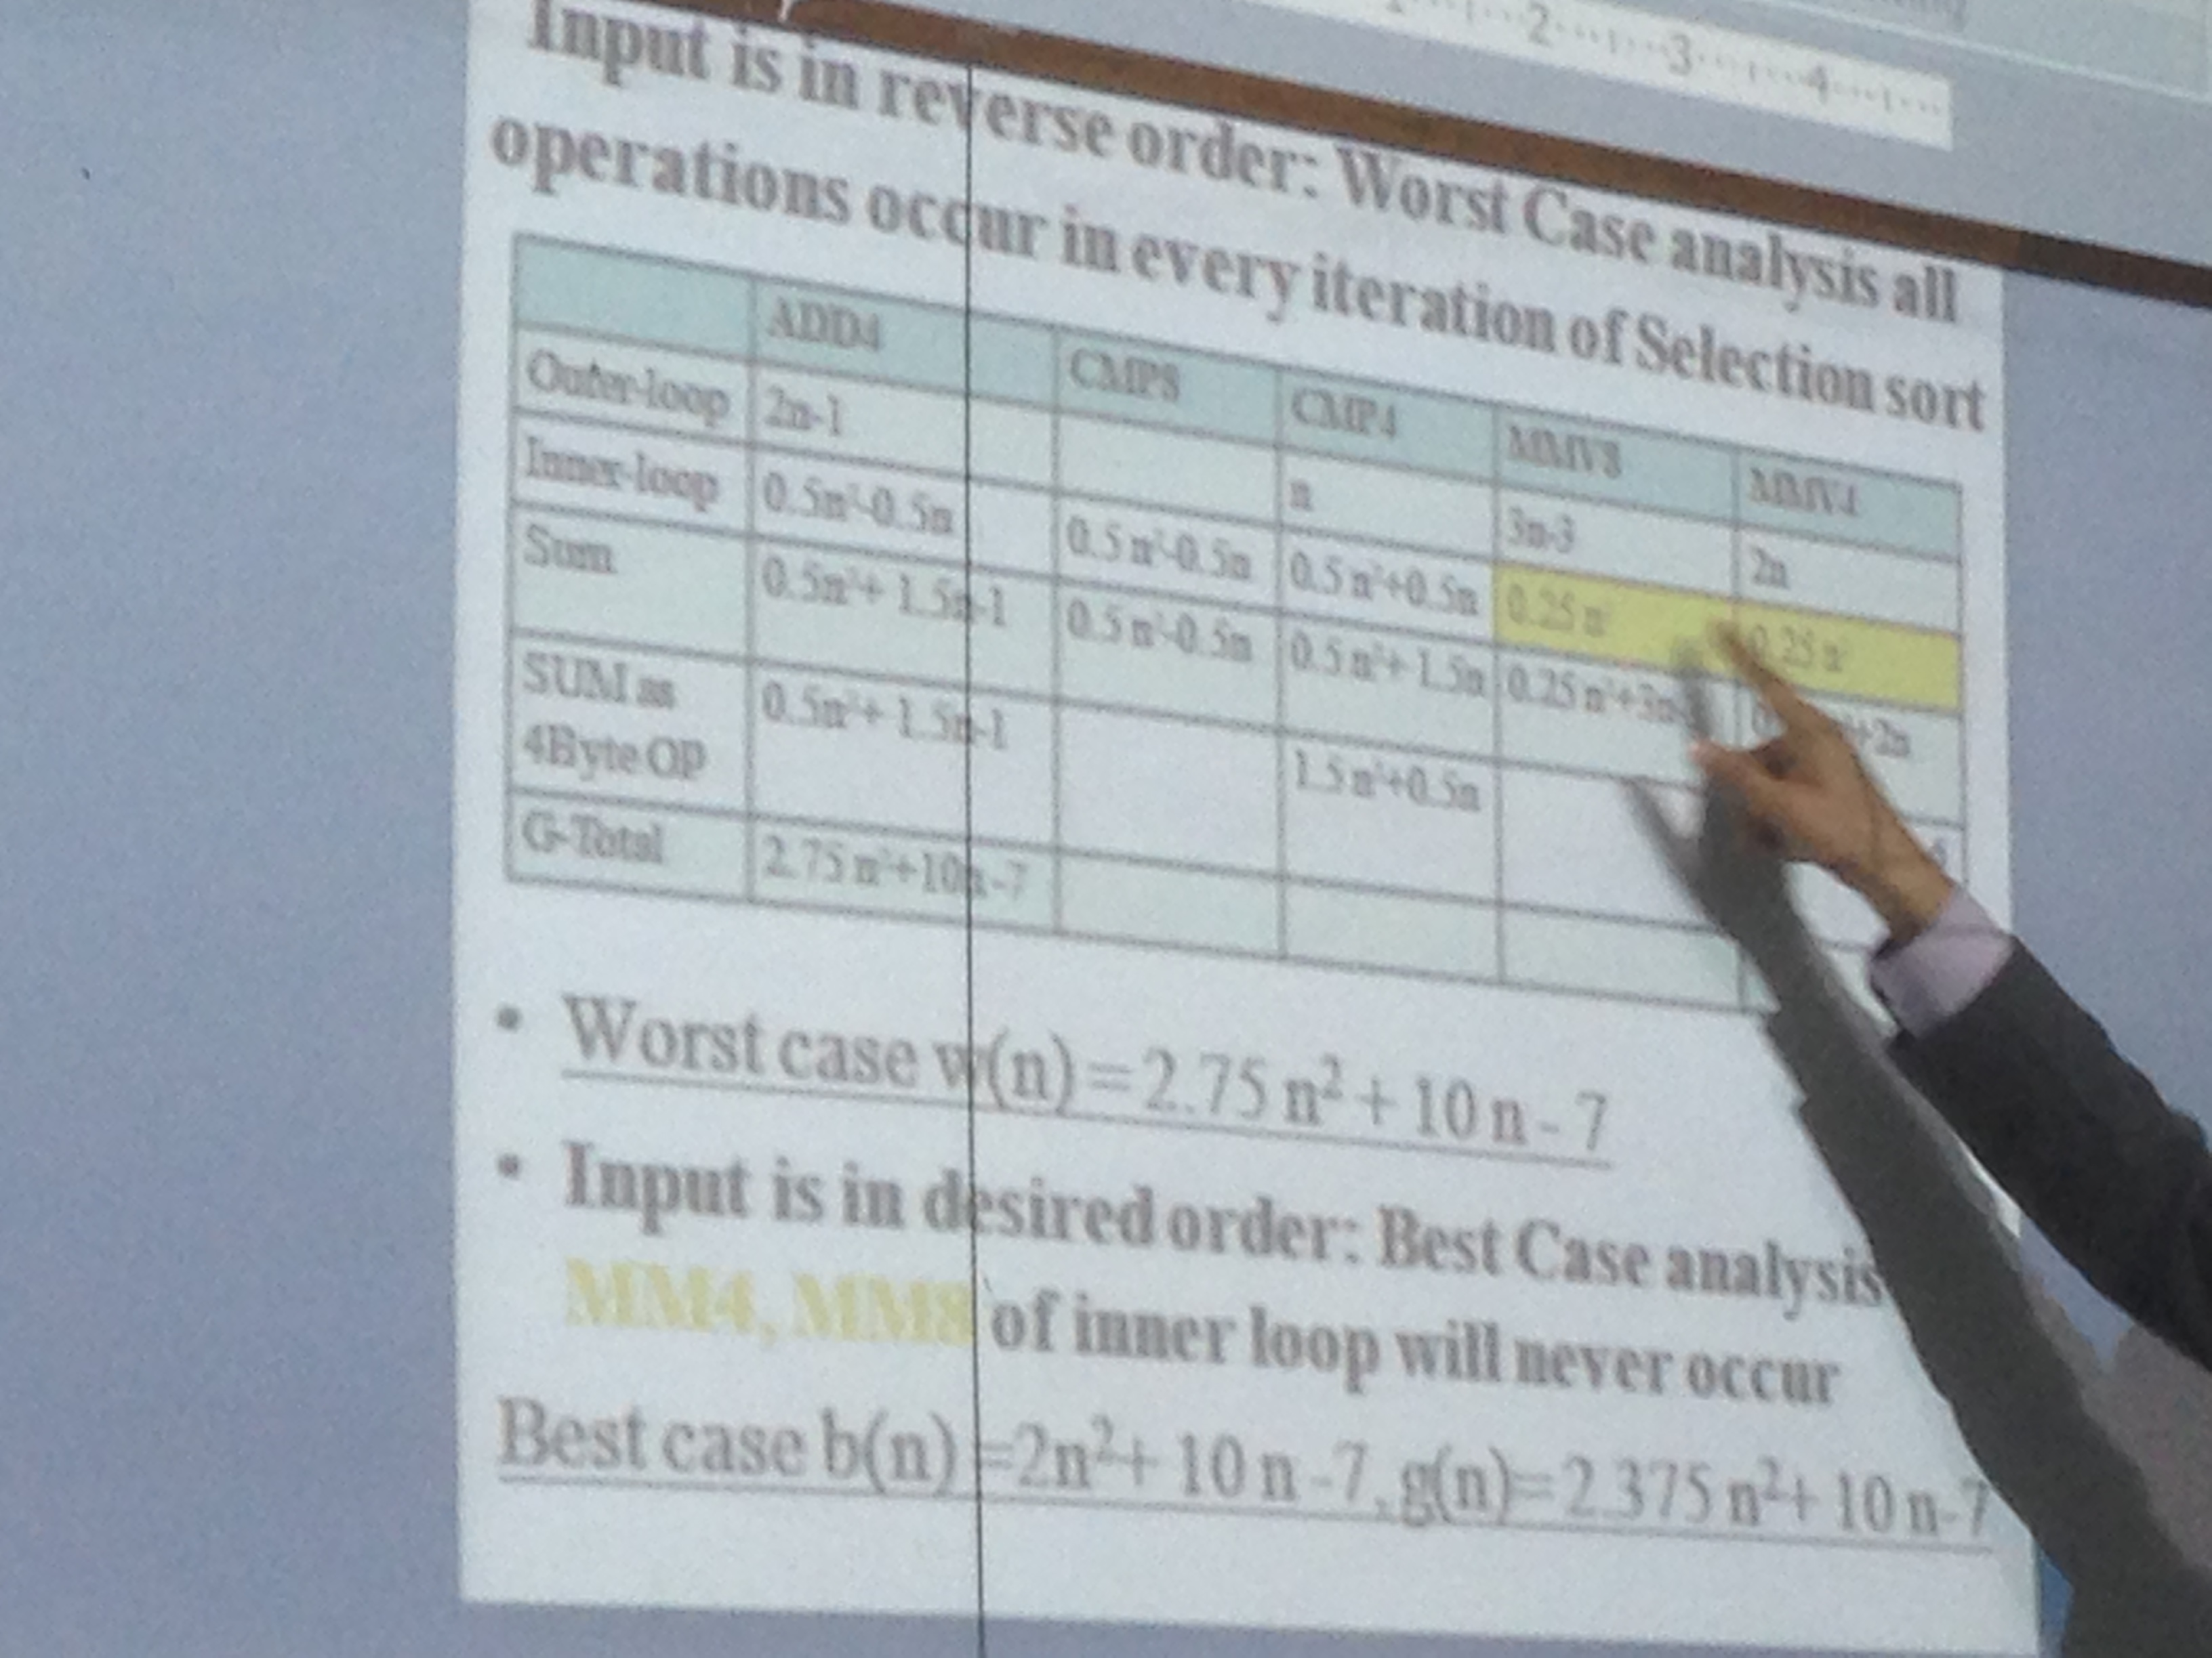
Growth of function (Selection Sort)

Slide 13
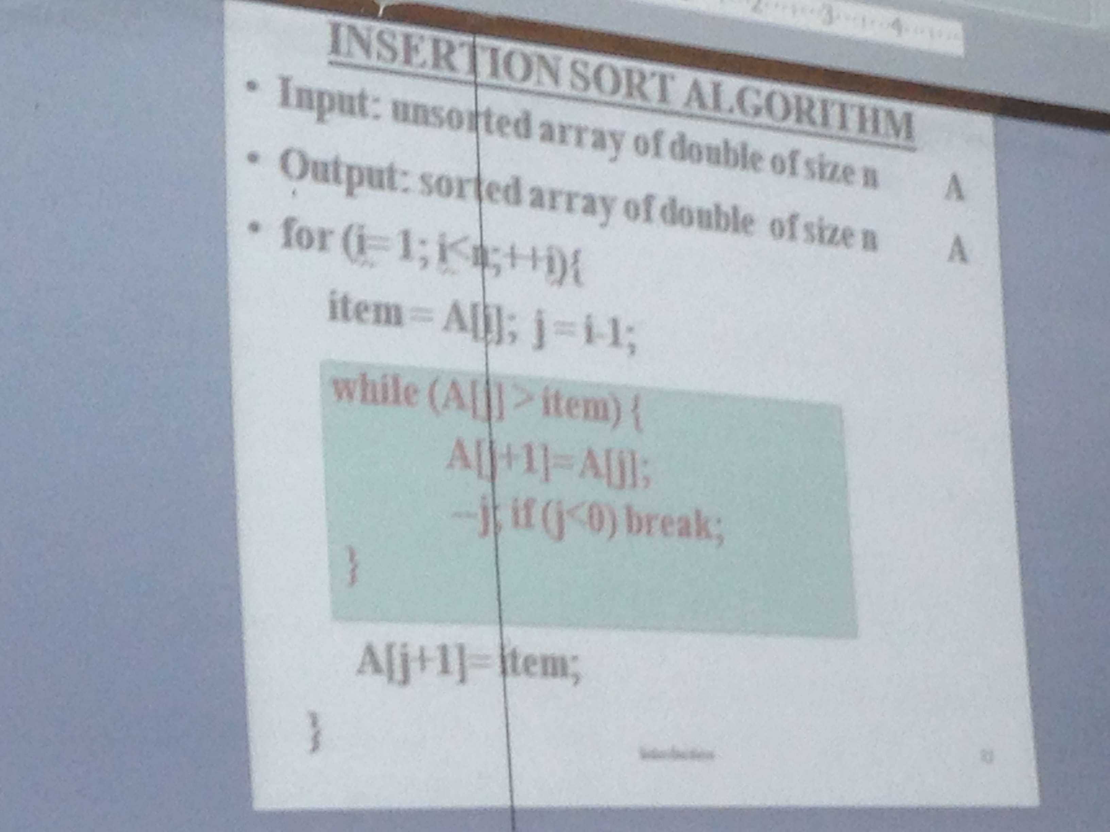
Insertion Sort Algorithm

Slide 14
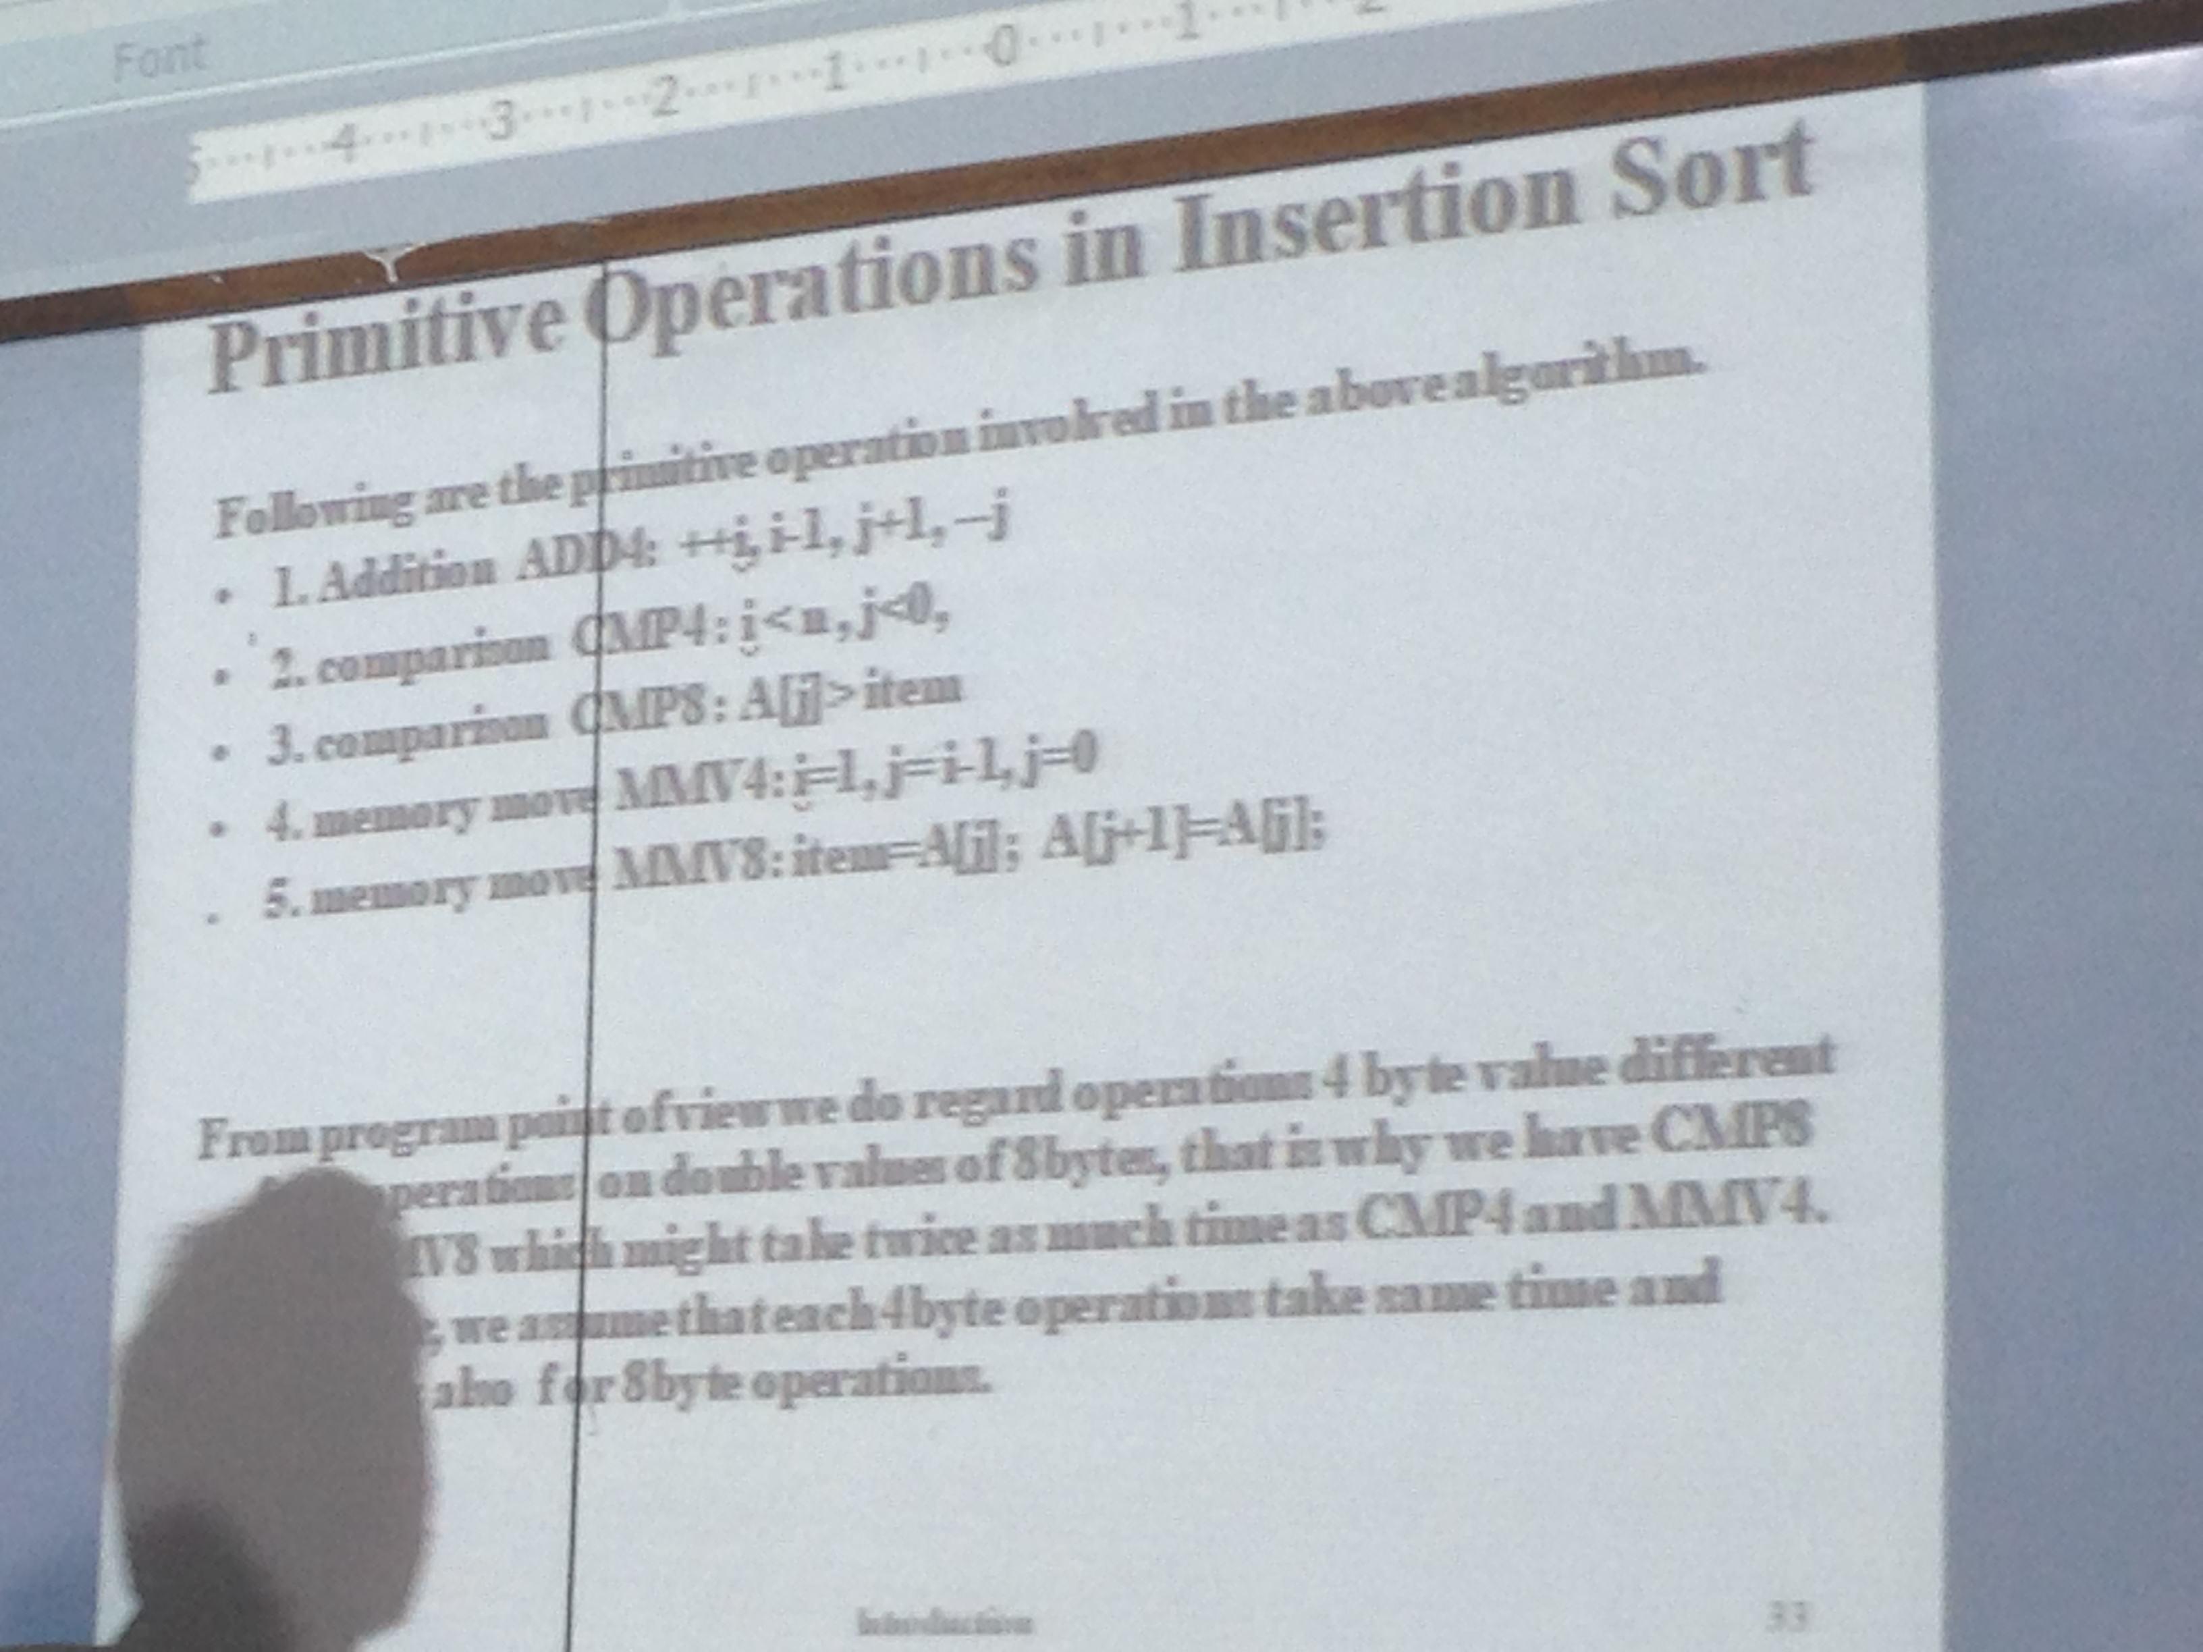
Insertion Sort Algorithm

Slide 15
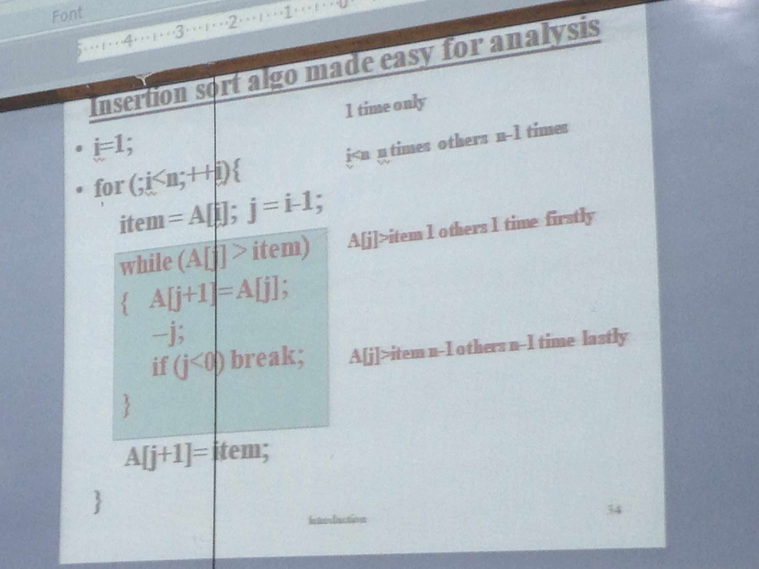
Insertion Sort Algorithm

Slide 16
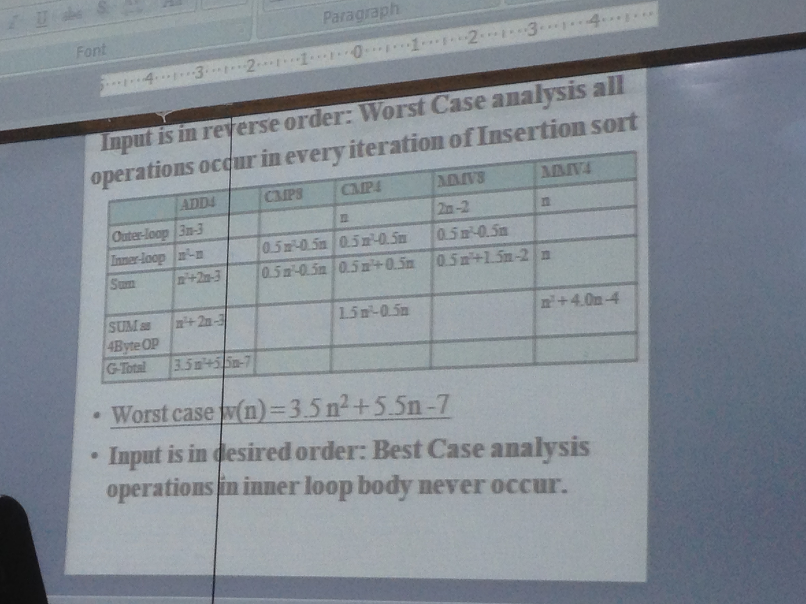
Growth of Function (Insertion Sort)

Slide 17
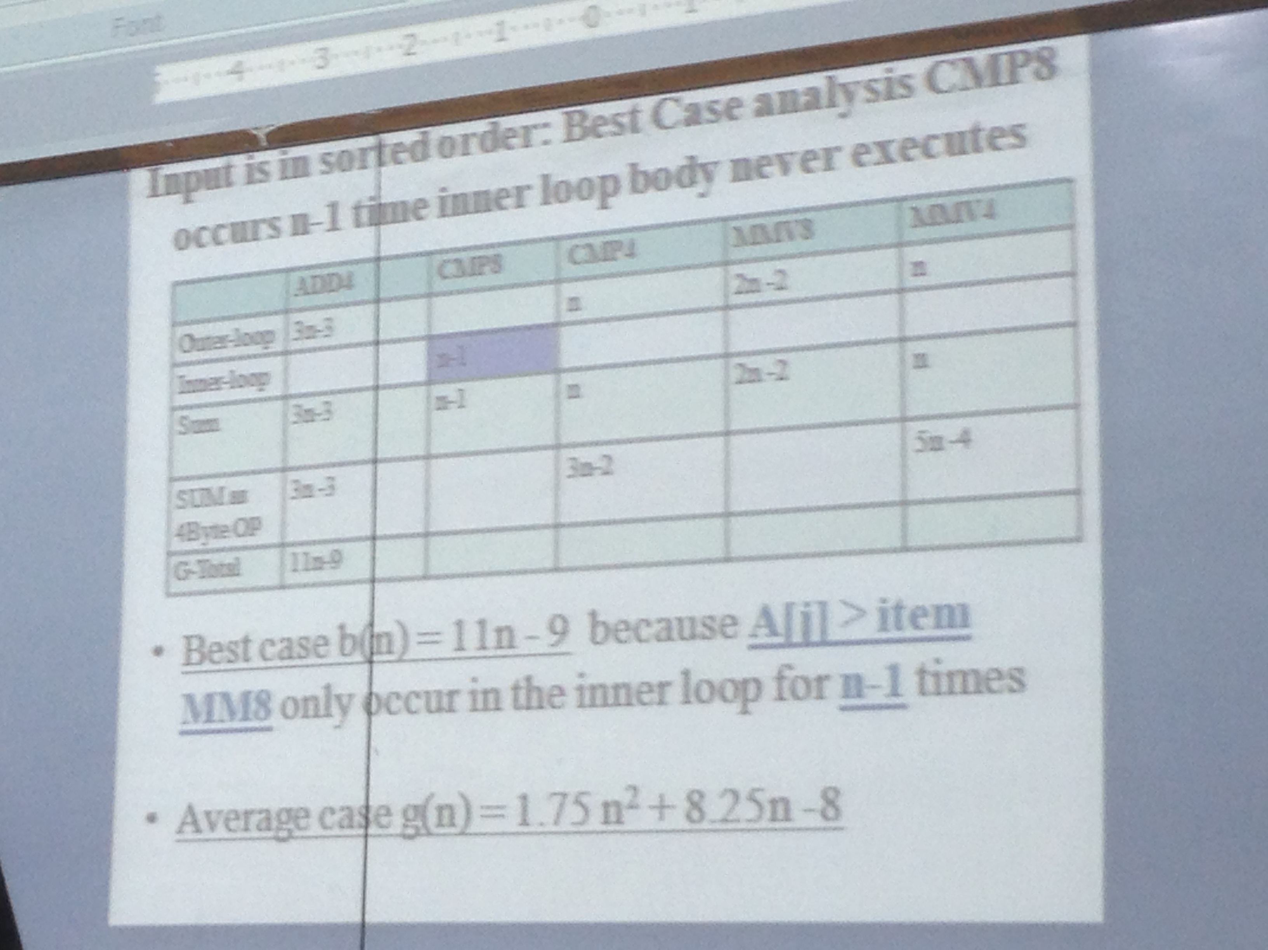
Growth of Function (Insertion Sort)

Slide 18
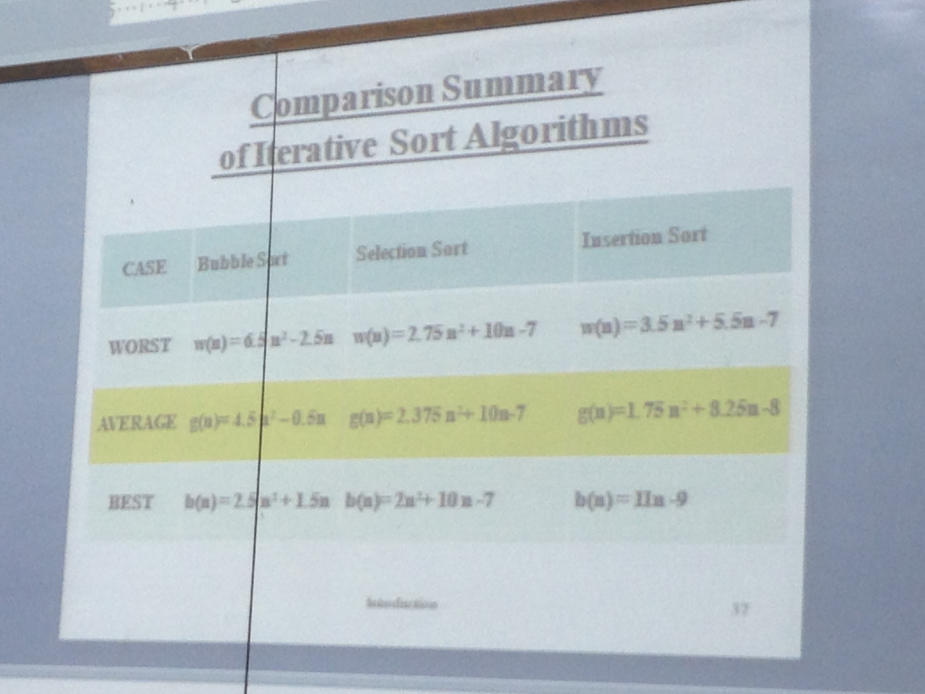
Comparison b/w Bubble sort, Selection sort and Insertion sort

Slide 19
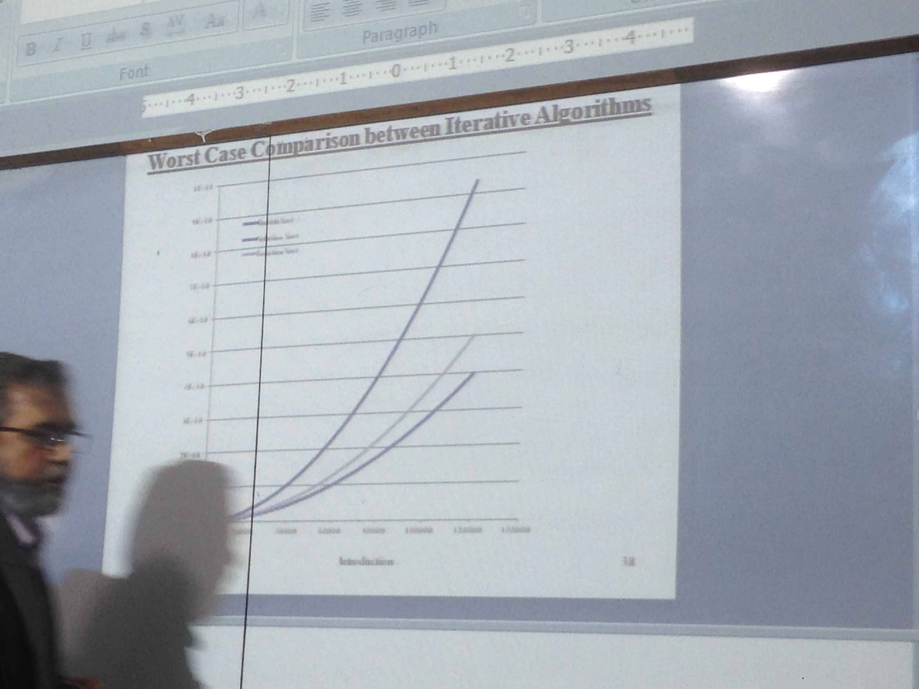
Comparison b/w Bubble sort, Selection sort and Insertion sort

Slide 20
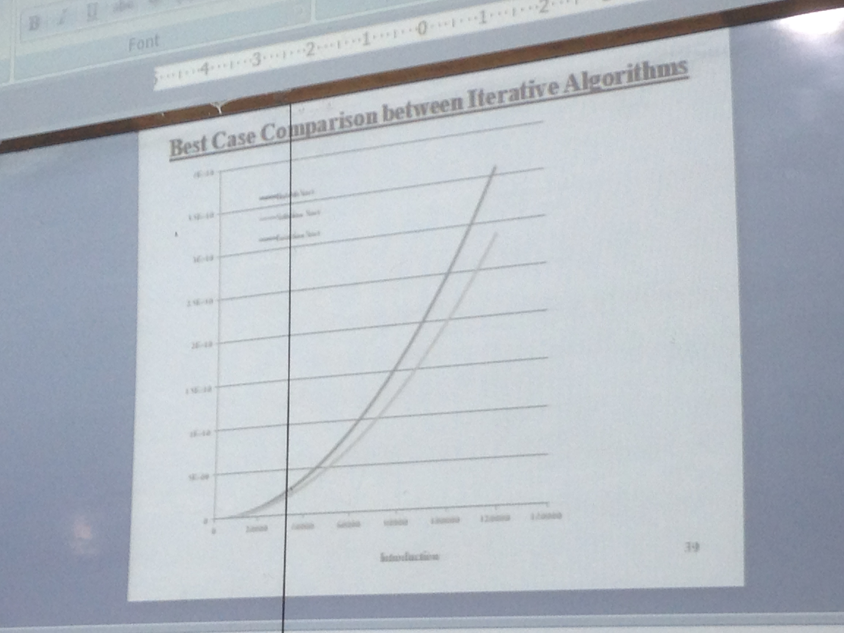
Comparison b/w Bubble sort, Selection sort and Insertion sort

Slide 21
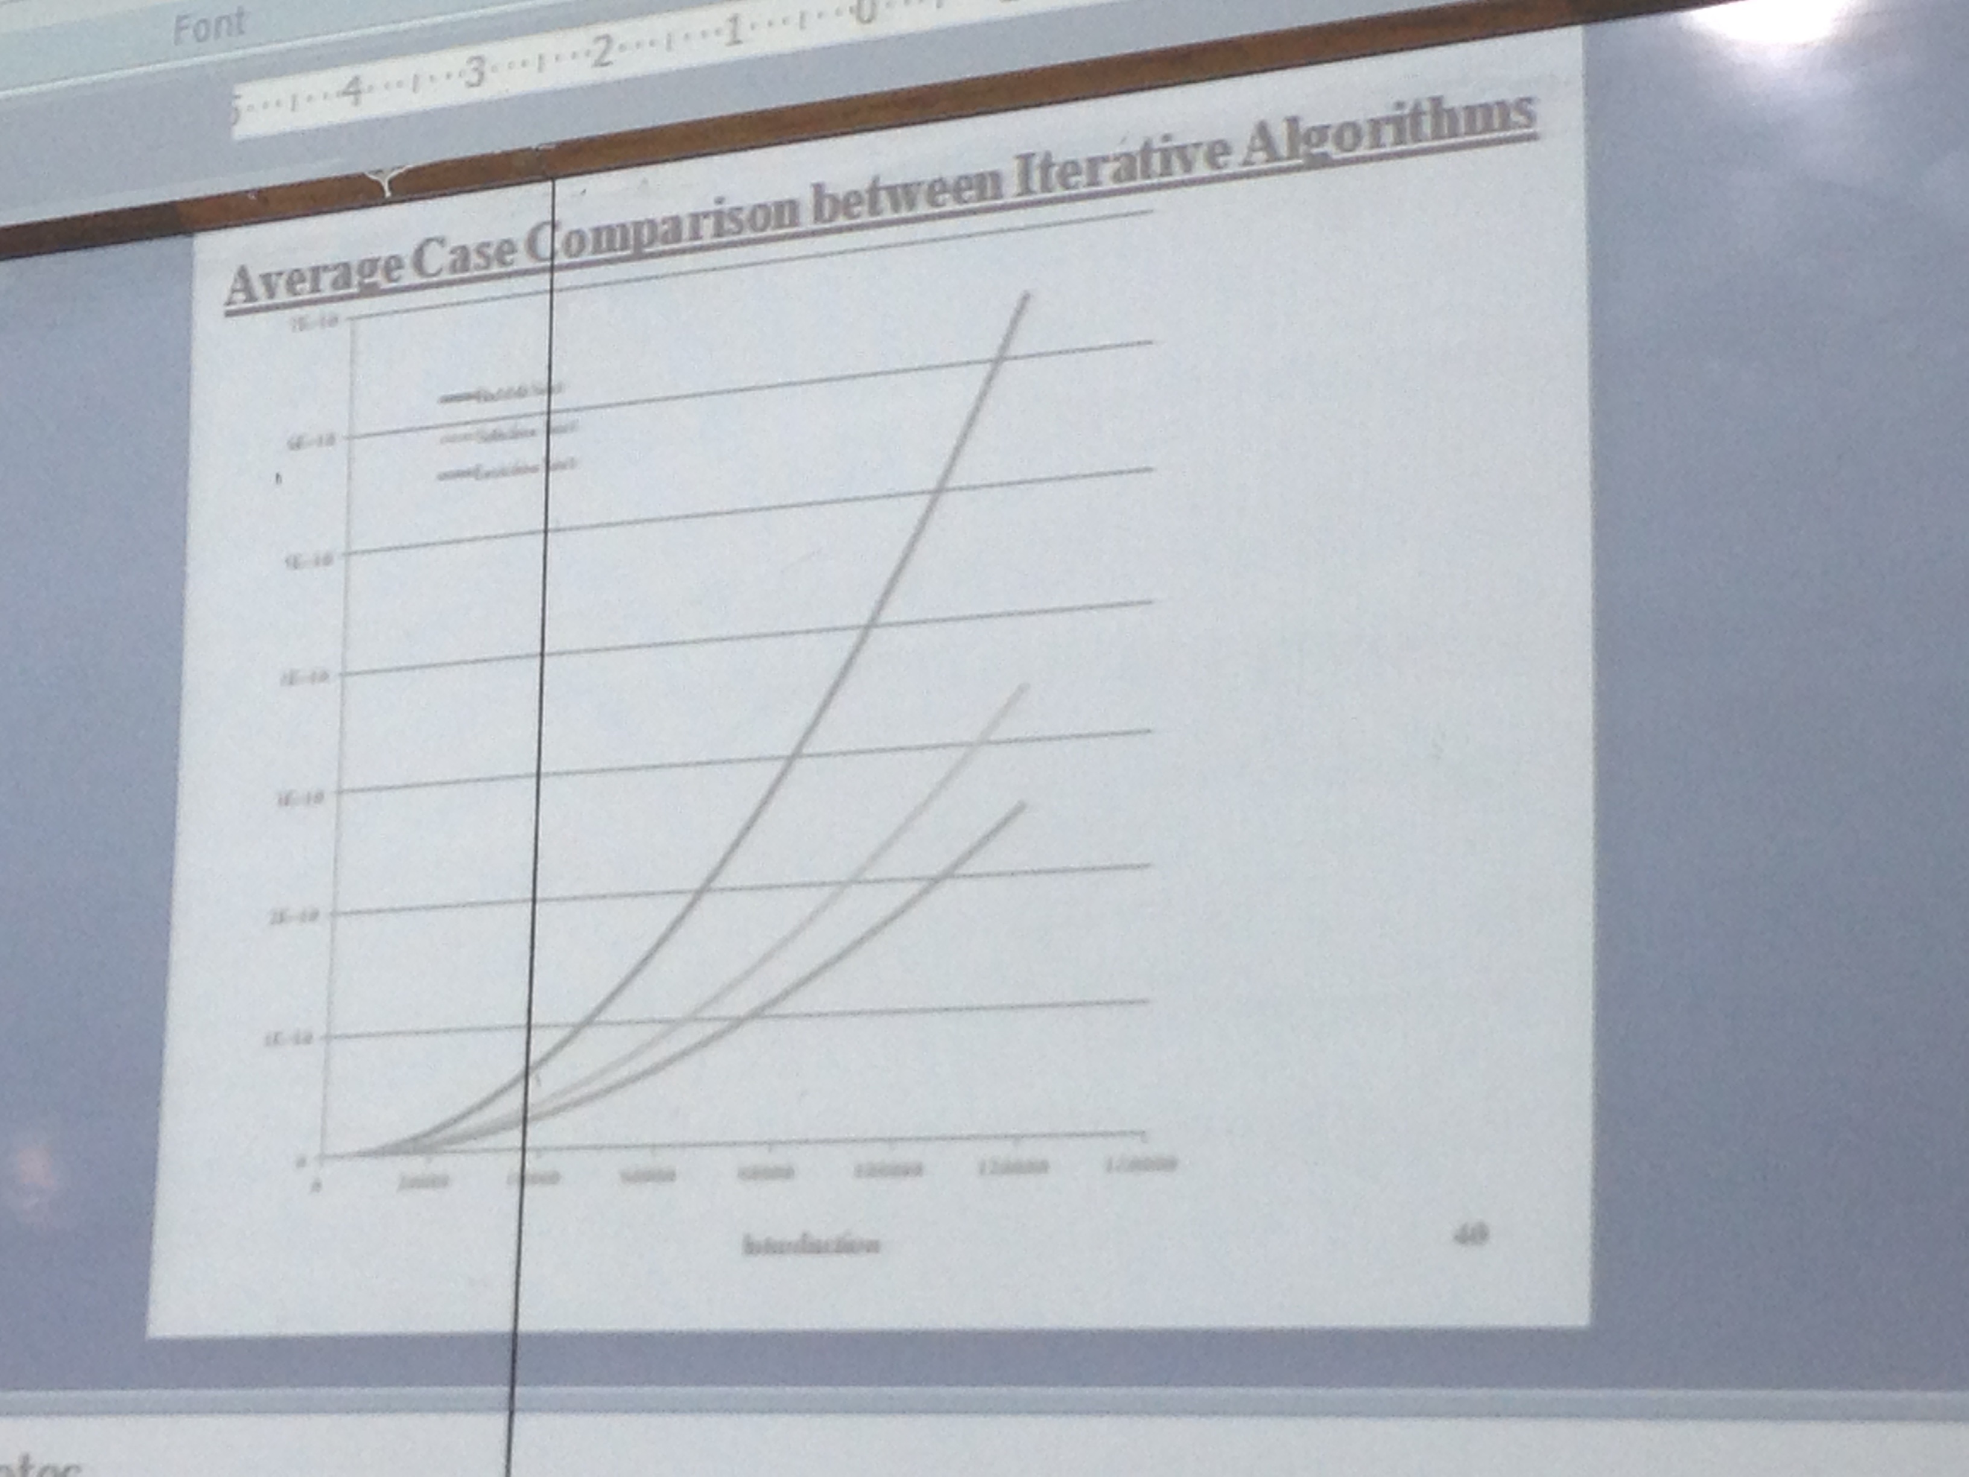
Comparison b/w Bubble sort, Selection sort and Insertion sort

Slide 22
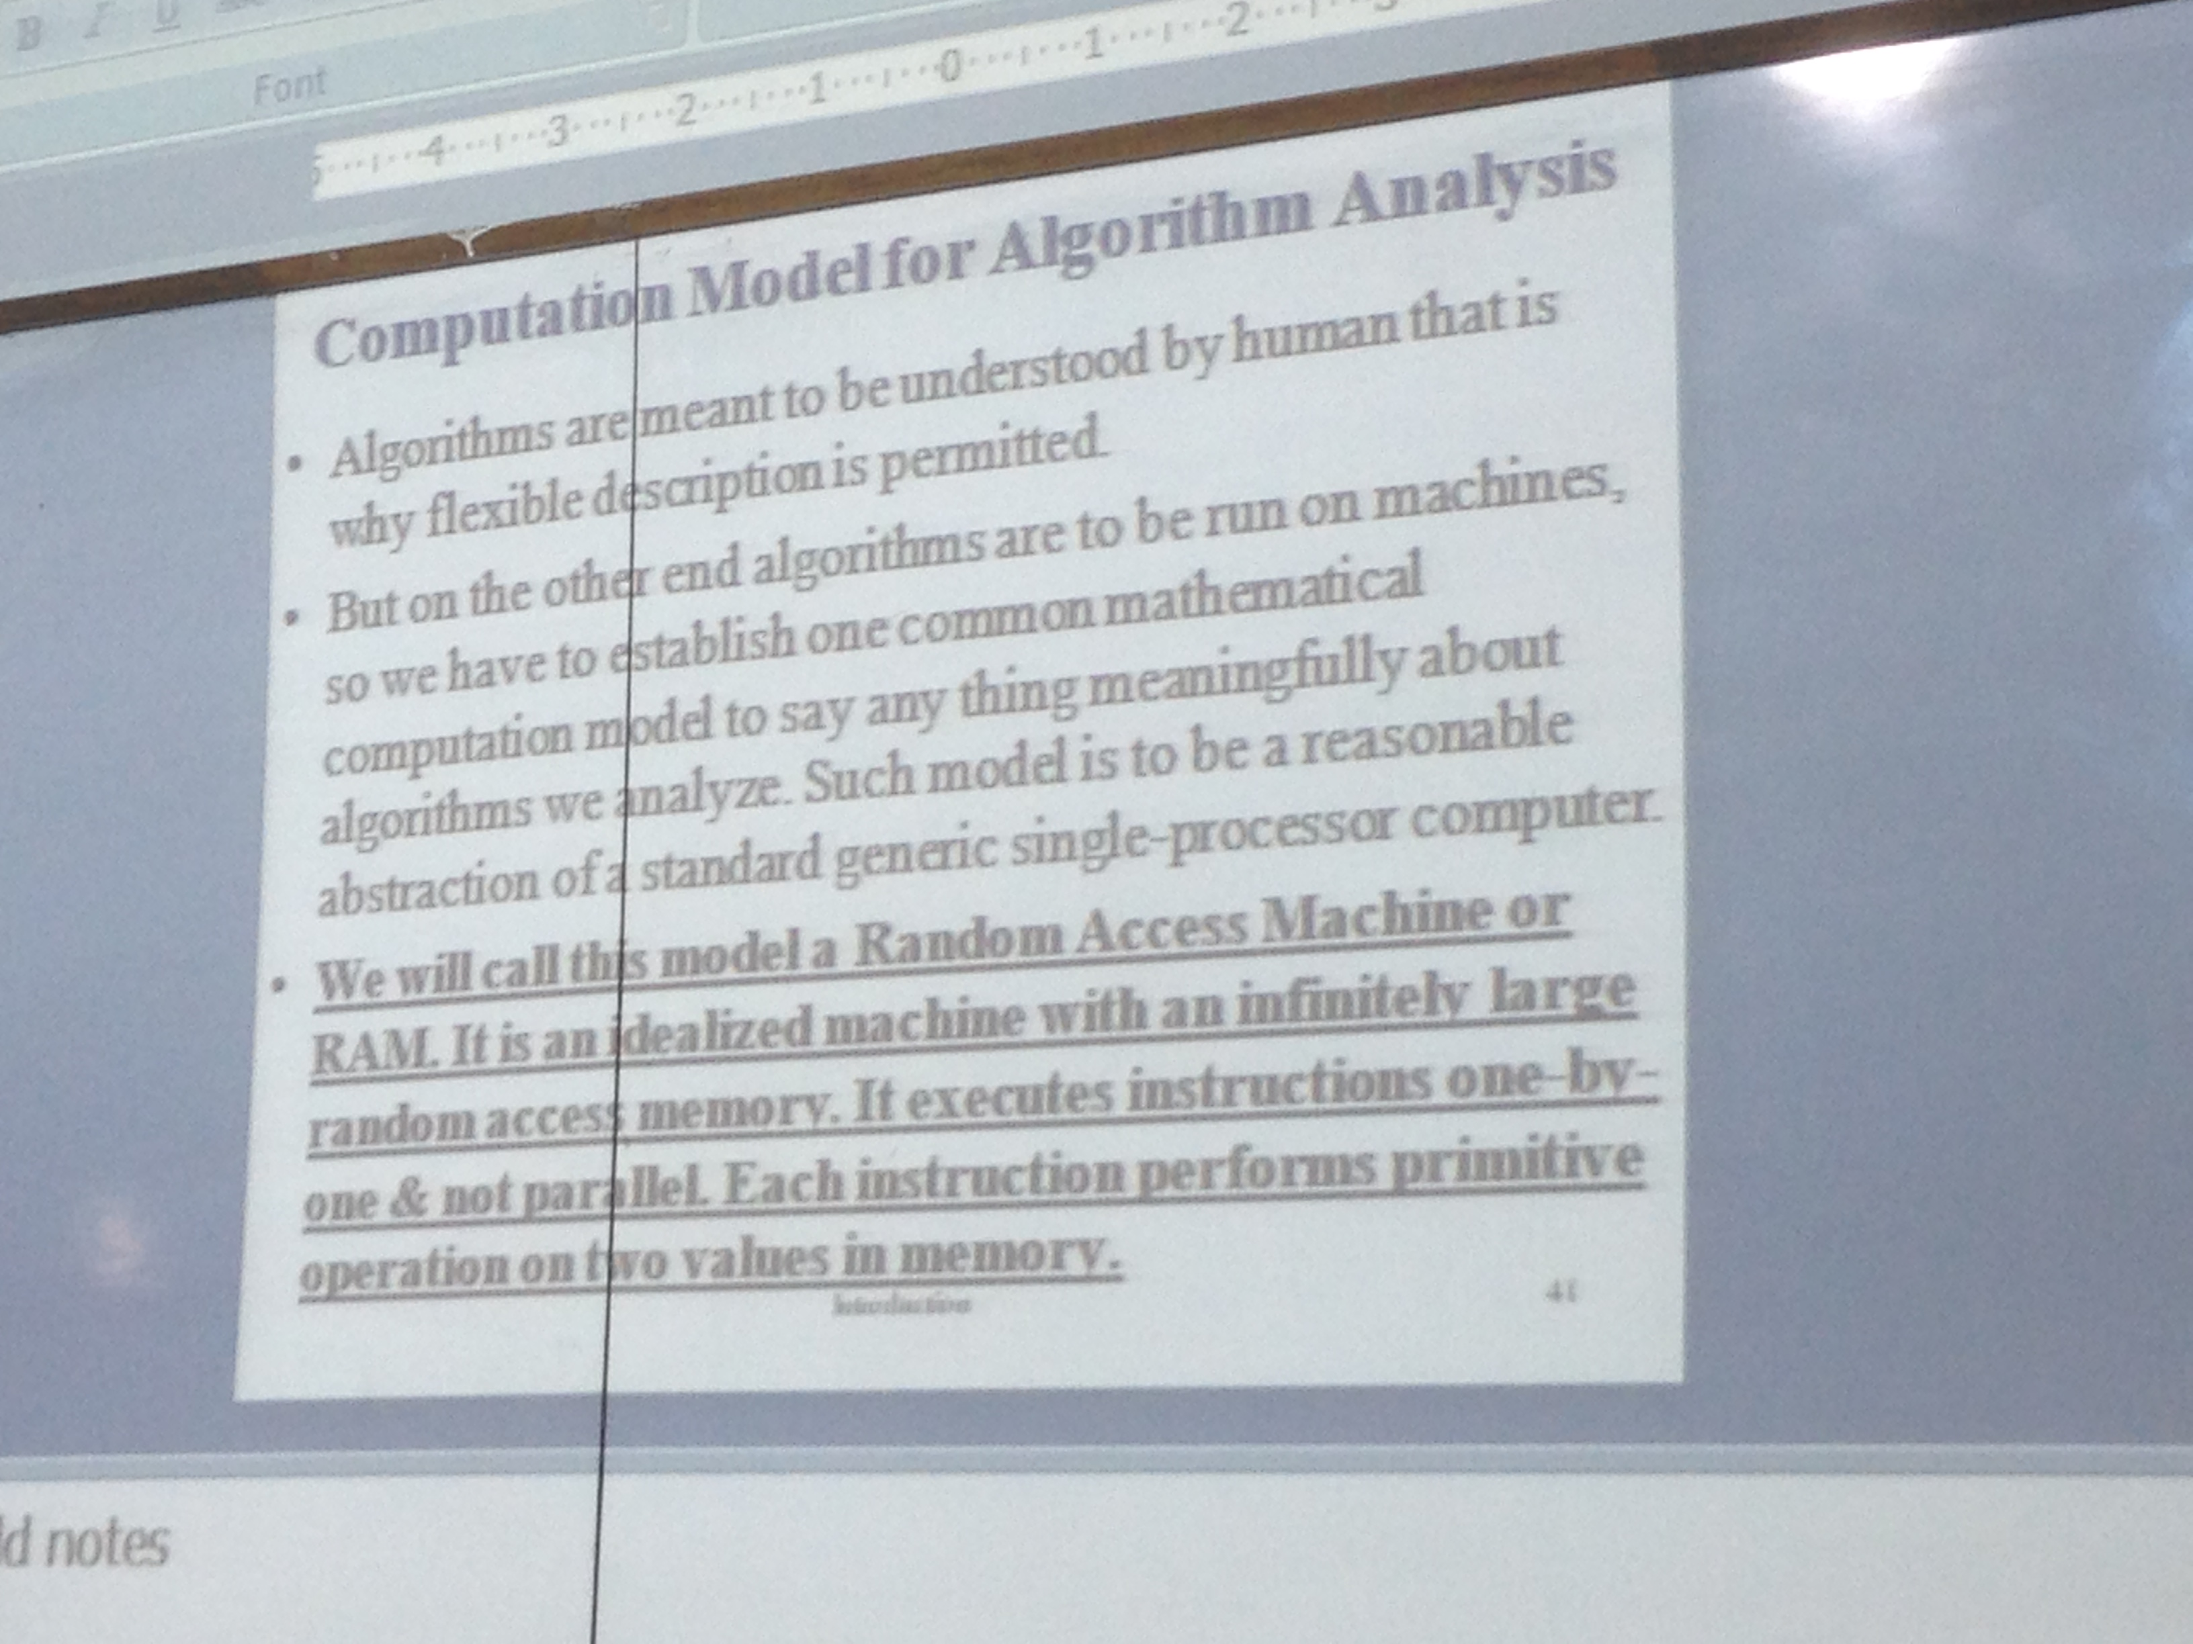
Computation model for algorithm analysis

Slide 23
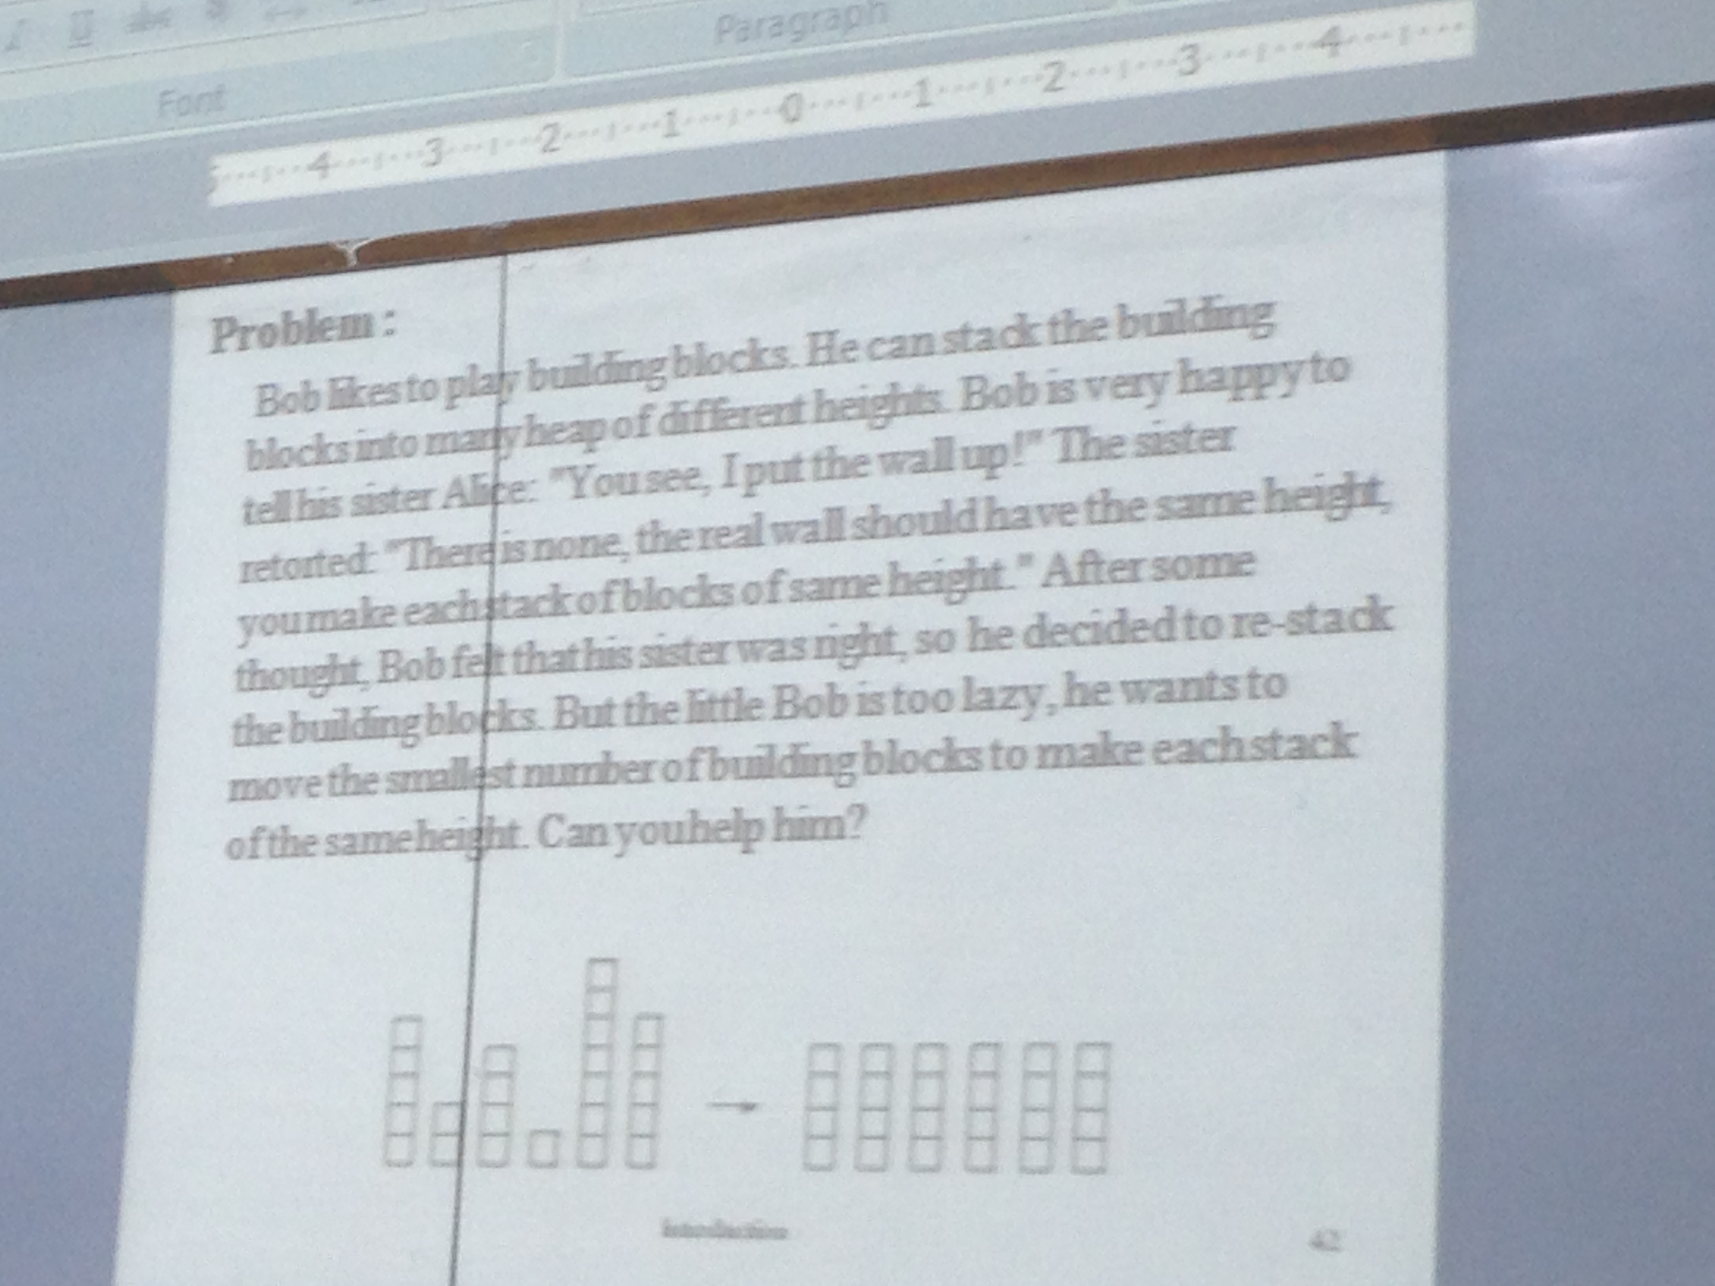
Problem # 1

Slide 24
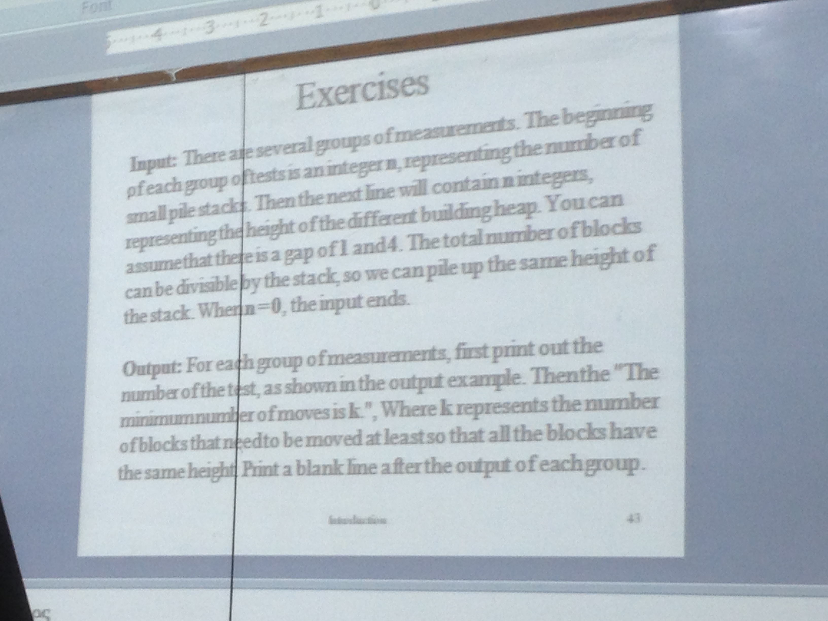
Analysis of Problem # 1

Slide 25
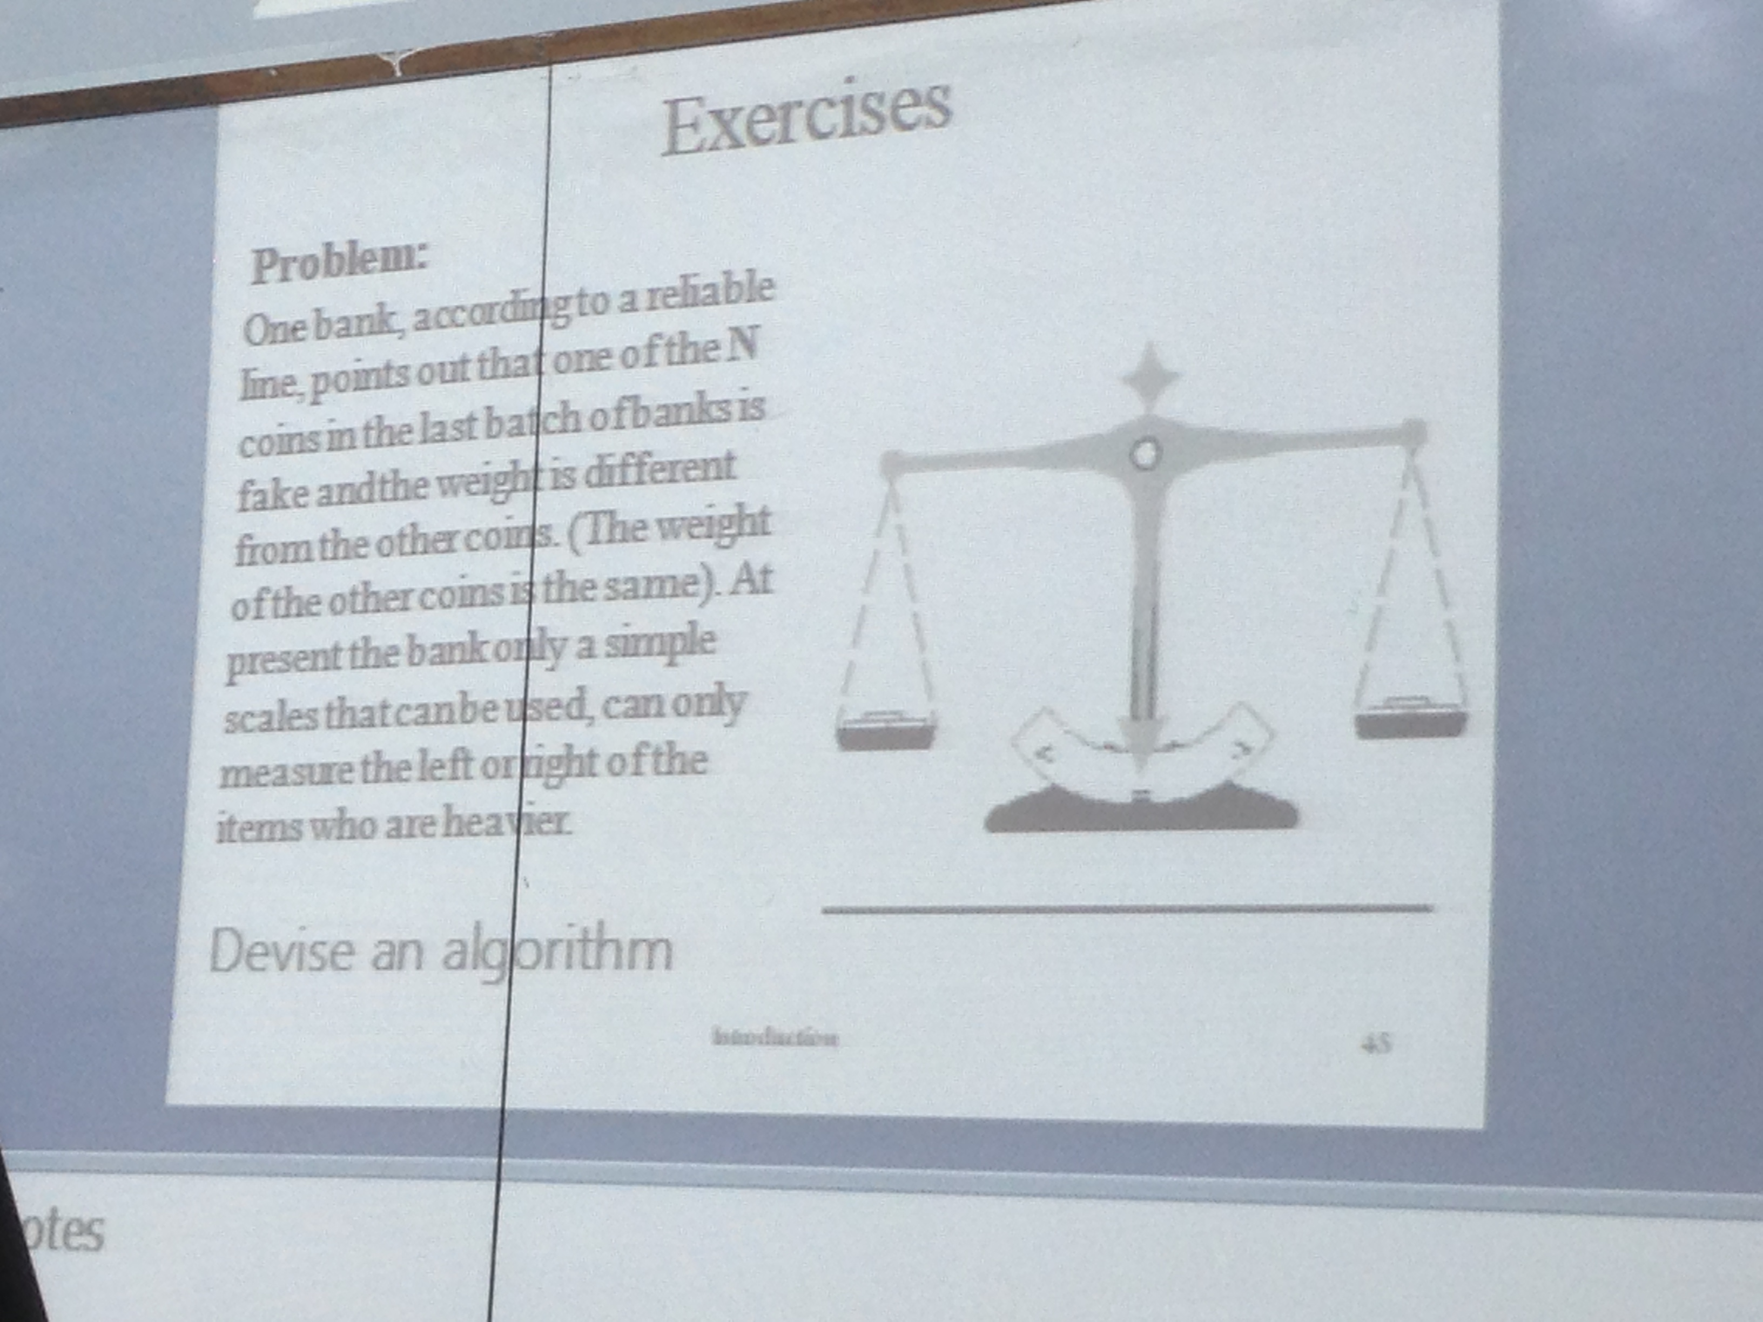
Problem # 2

